Slide 1
Applied Deep Learning
Module 1:
Preface
Chapter 1
Chapter 5
Notes:
These are notes for the slide

Slide 2
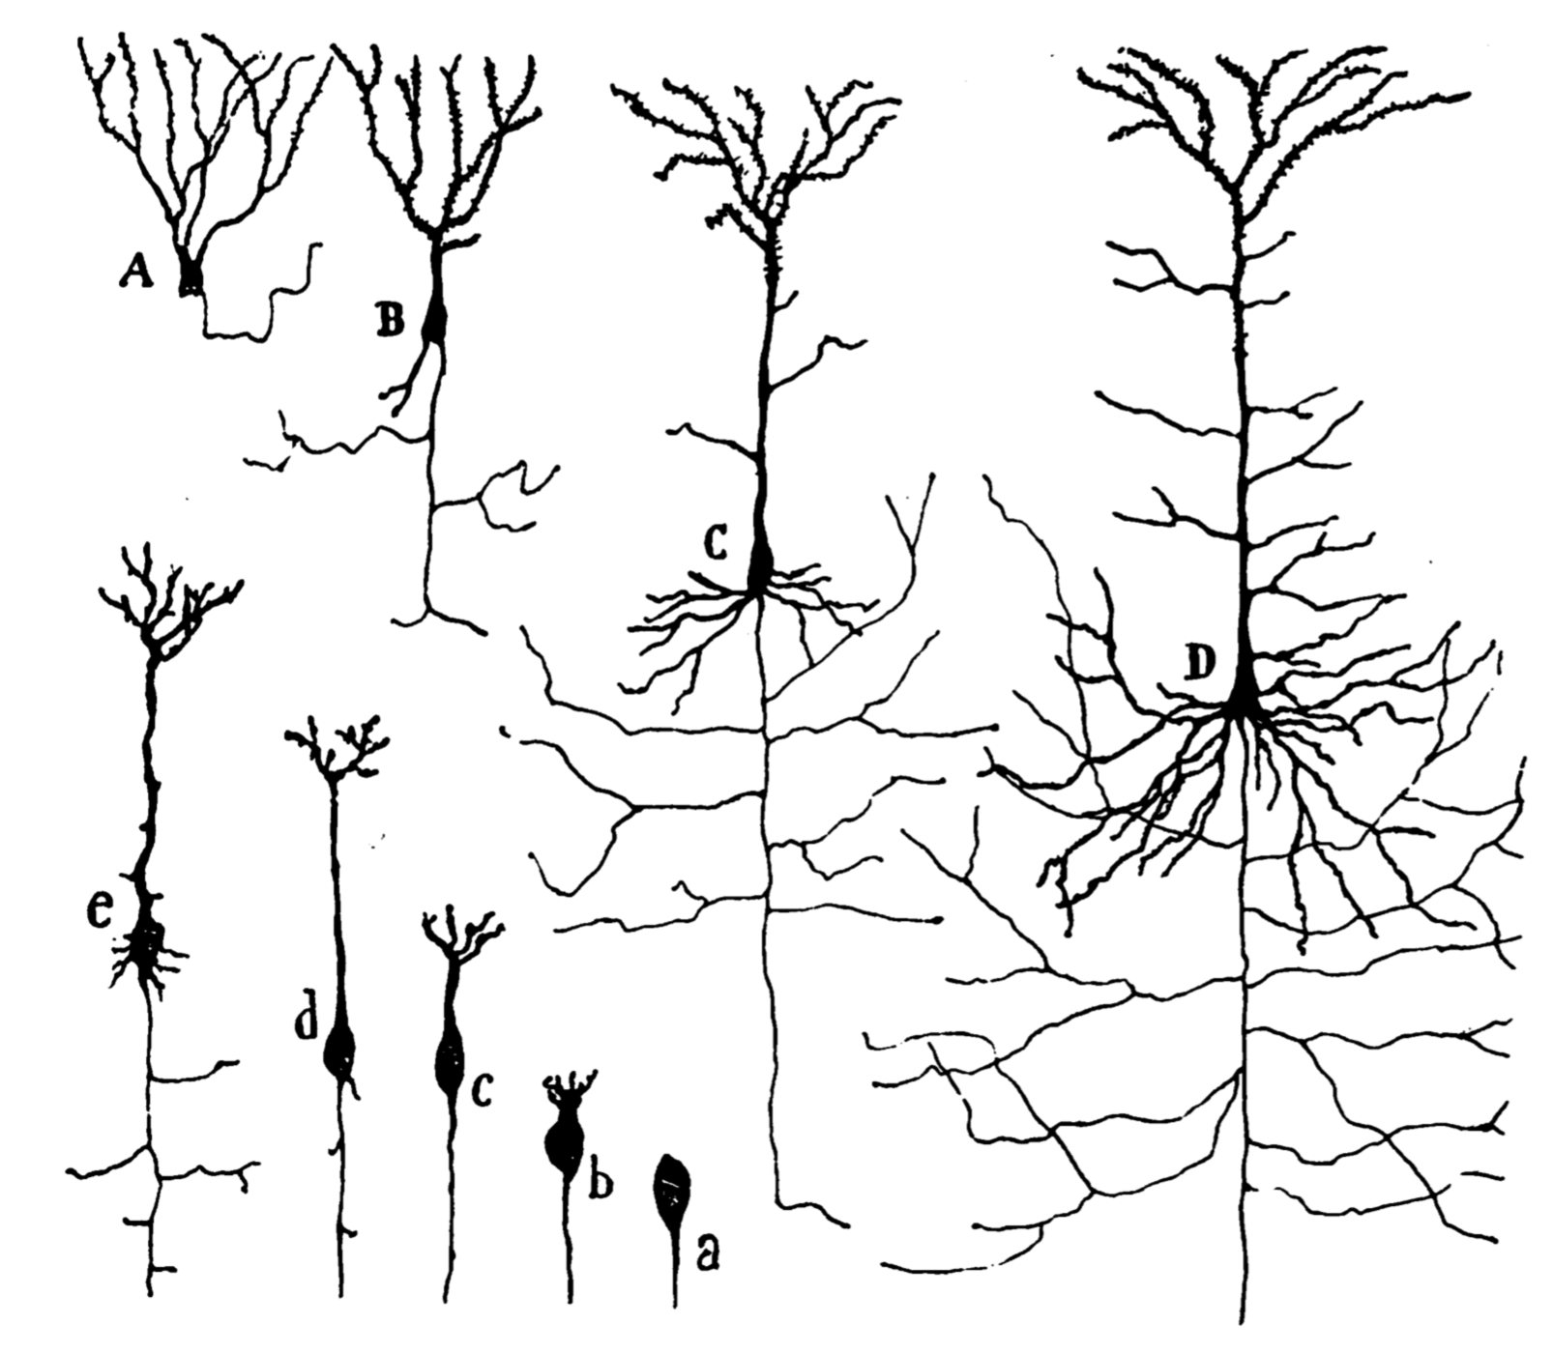
Preface
Beginnings of Artificial Neurons

Slide 3
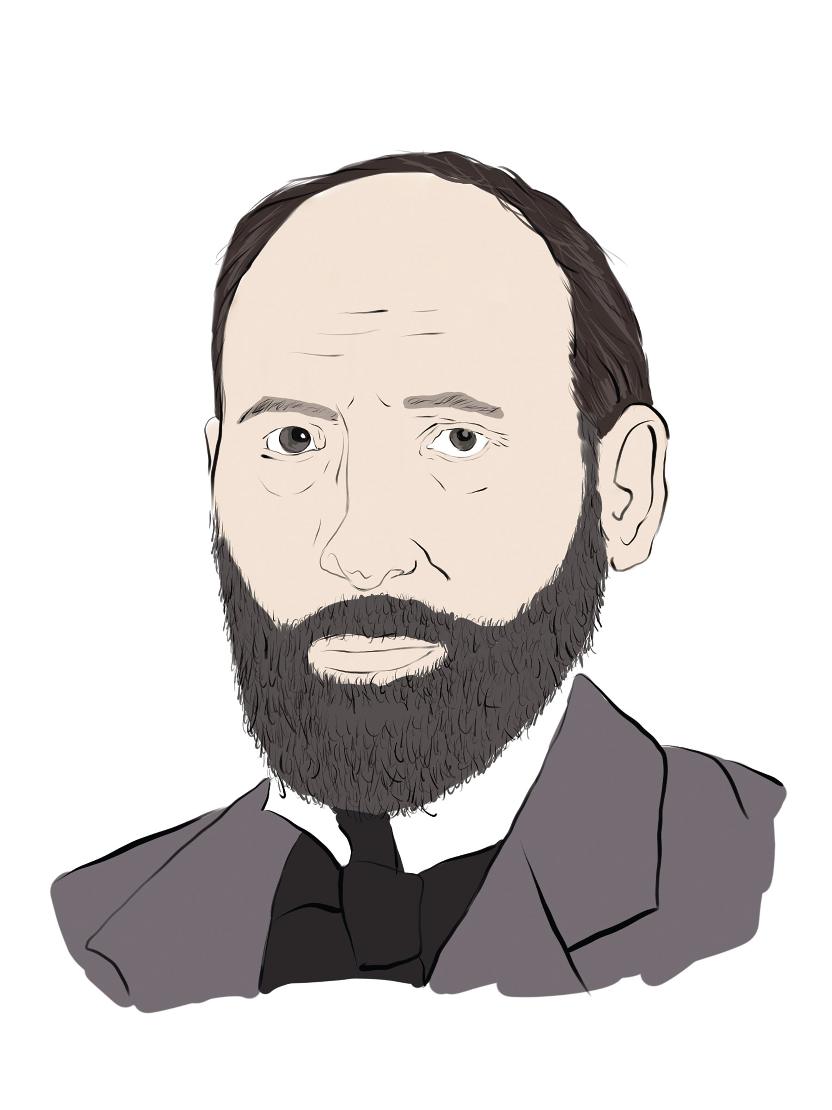
Santiago Cajal (1852-1934)
Notes:
Spanish physician first to identify neurons, or brain cells that make up the human nervous system.
By the 1950’s, scientists began experimenting with computer-based artificial neurons.

Slide 4
Notes:
Cajal’s hand-drawn diagram (1894)
a-e: growth of a neuron.
A: frog neuron
B: lizard neuron
C: rat neuron
D: human neuron

Slide 5
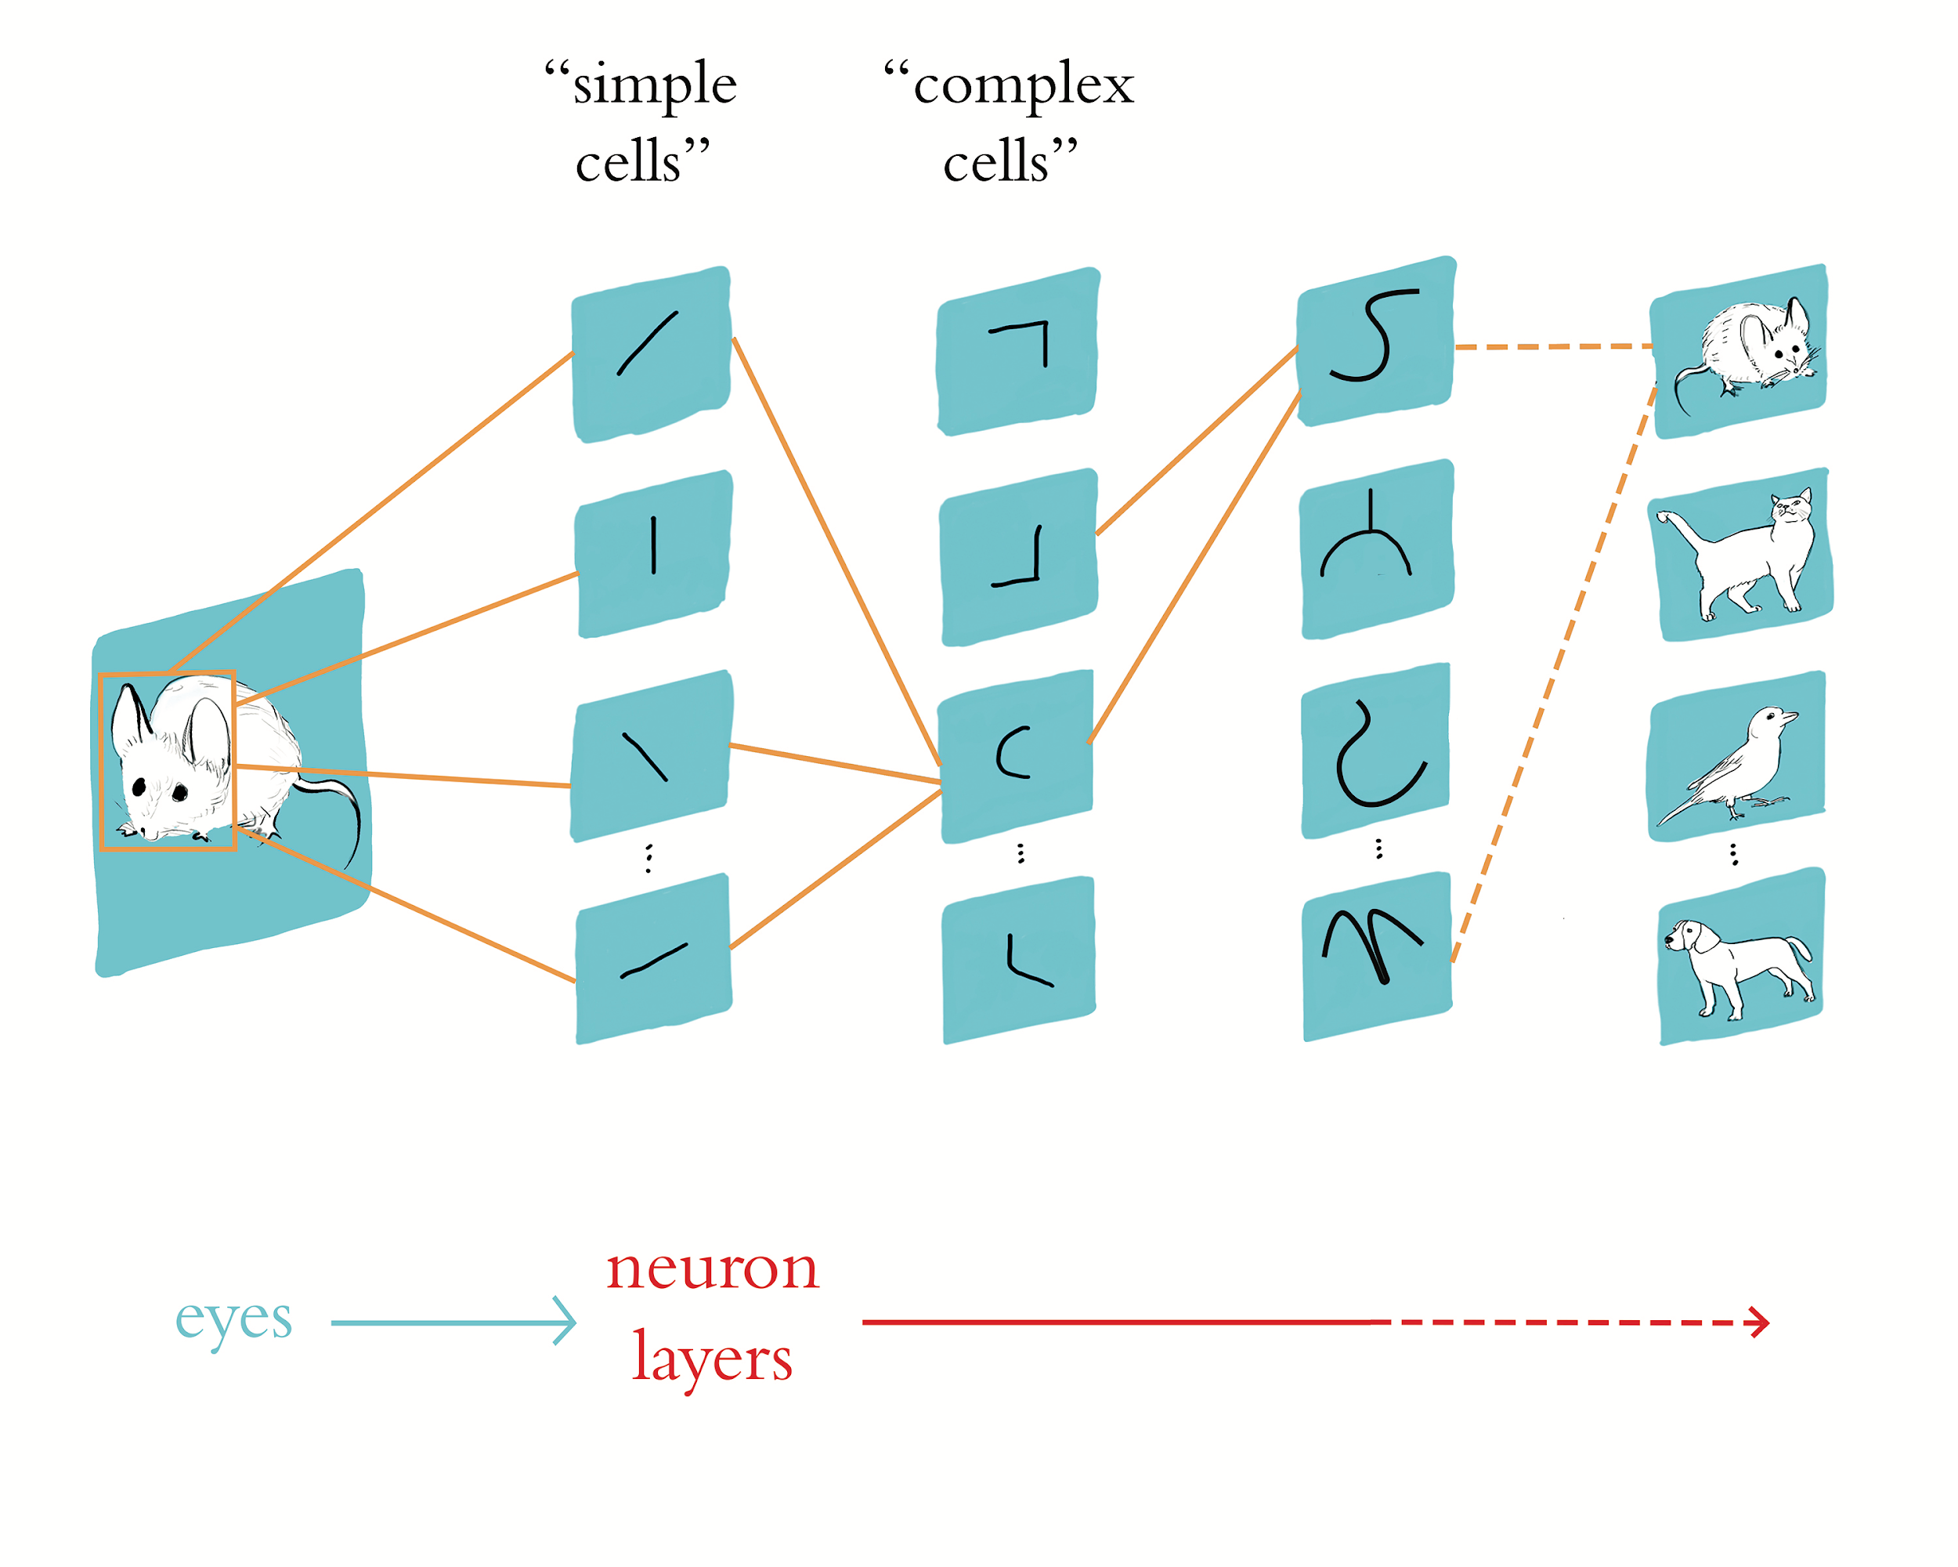
Chapter 1
Biological and Machine Vision

Slide 6
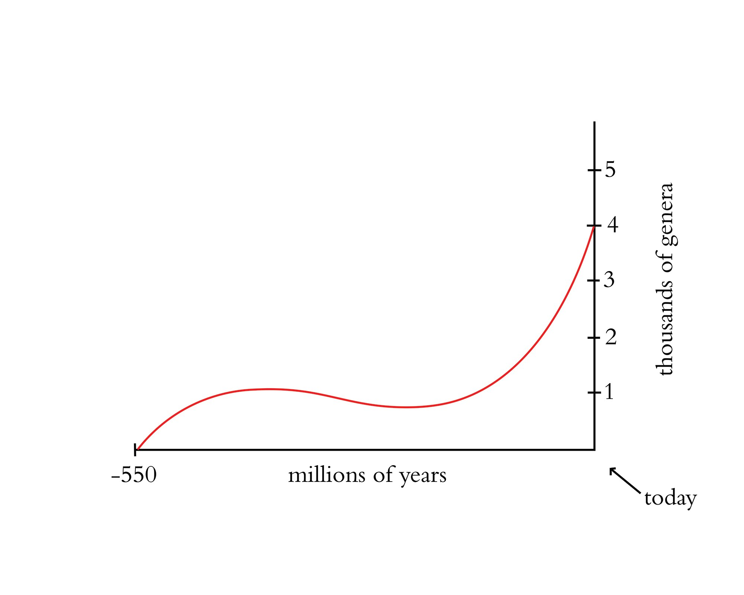
Notes:
The number of species on the planet began to increase rapidly 550 million years ago.
Genera are categories of related species.

Slide 7
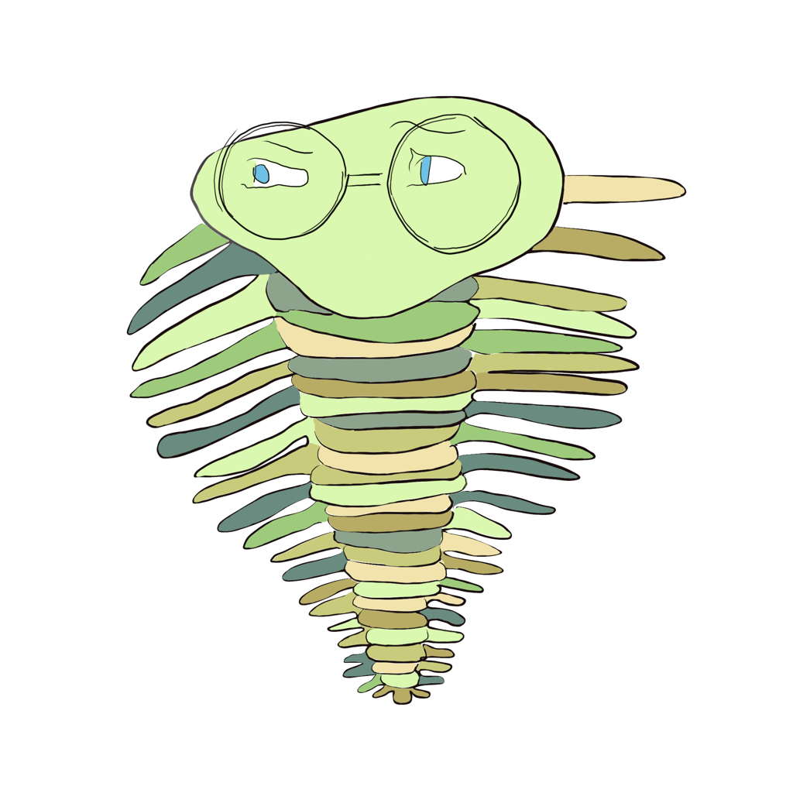
Notes:
Increase in species related to the development of light detectors (vision system) in the trilobite.
The complexity of the vision system has evolved considerably in the years since the trilobite.
A large portion of the cerebral cortex of modern mammals is involved in visual perception.

Slide 8
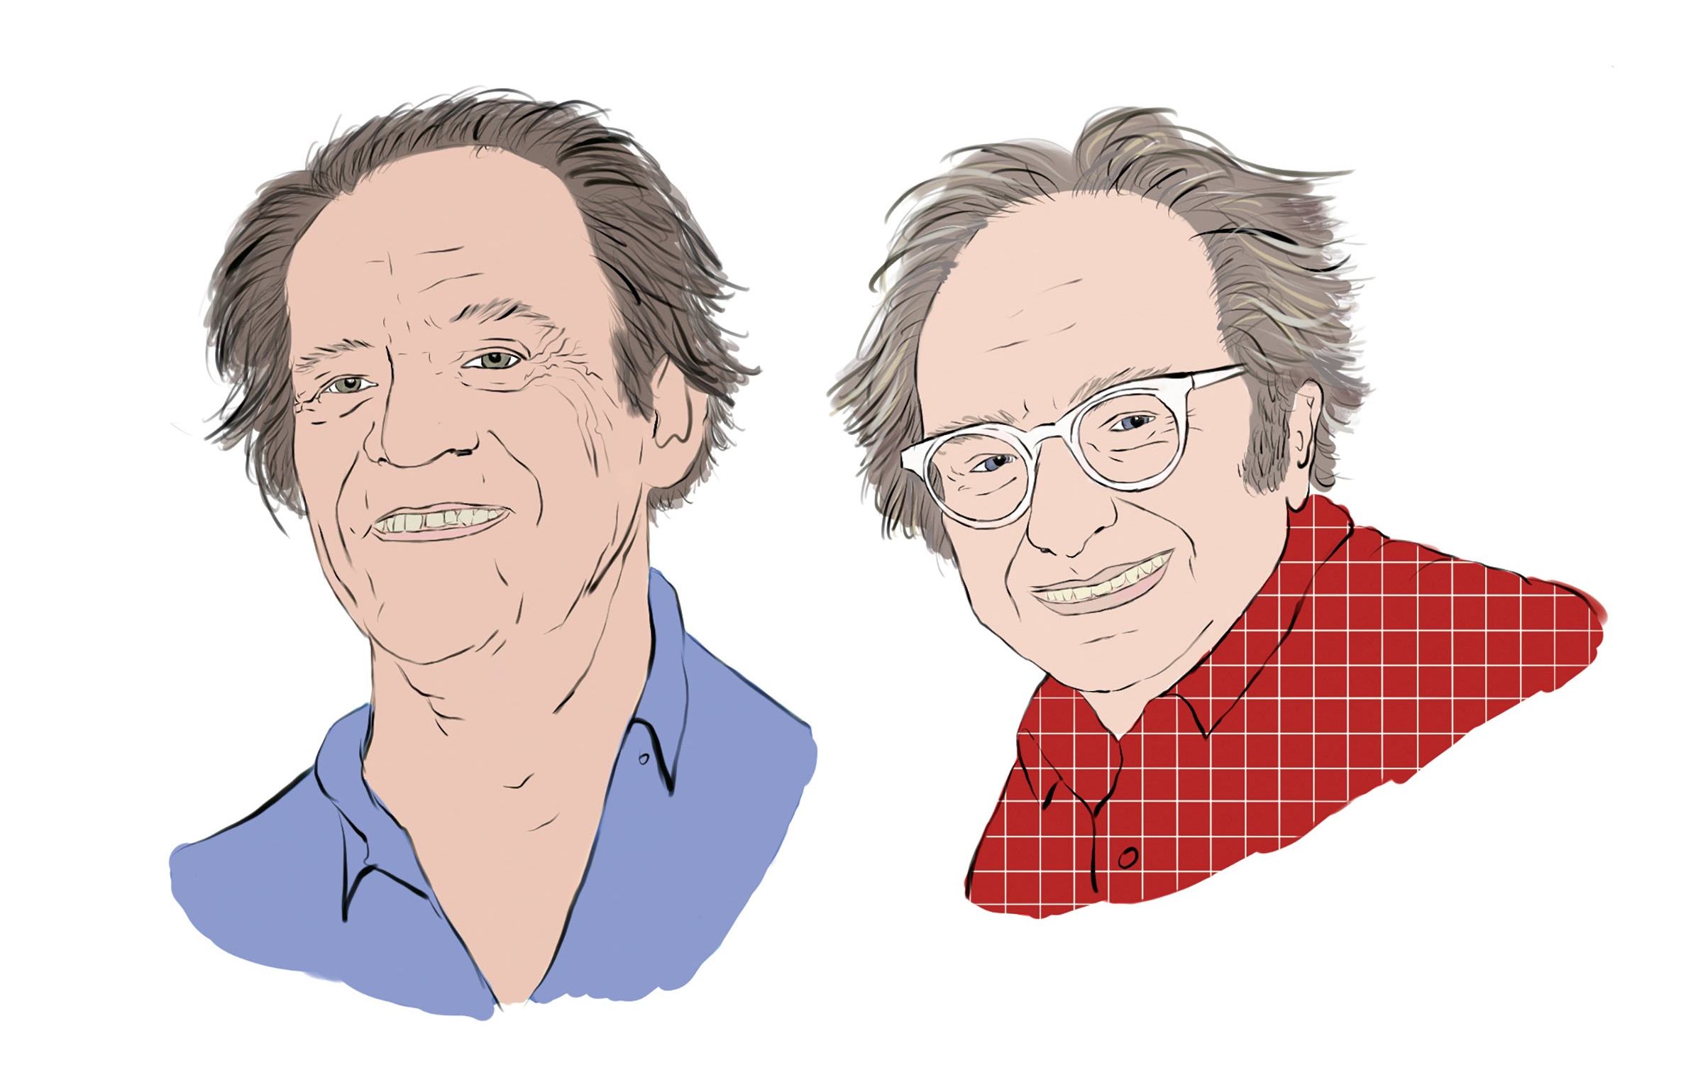
Torsten Wiesel and David Hubel

Slide 9
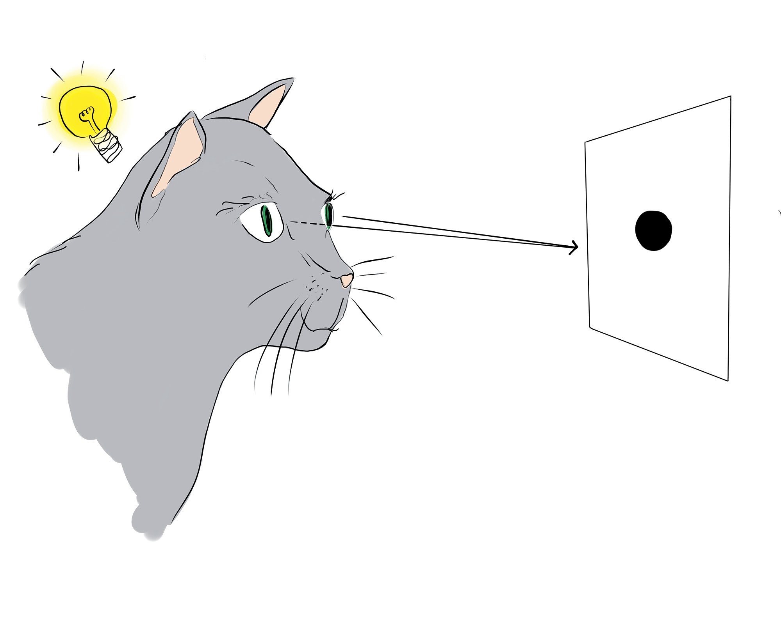

Slide 10
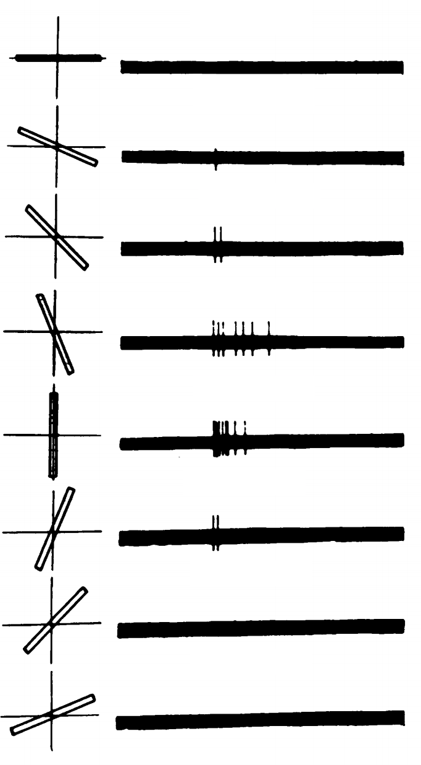
Hubel & Wiesel (1959)

Slide 12
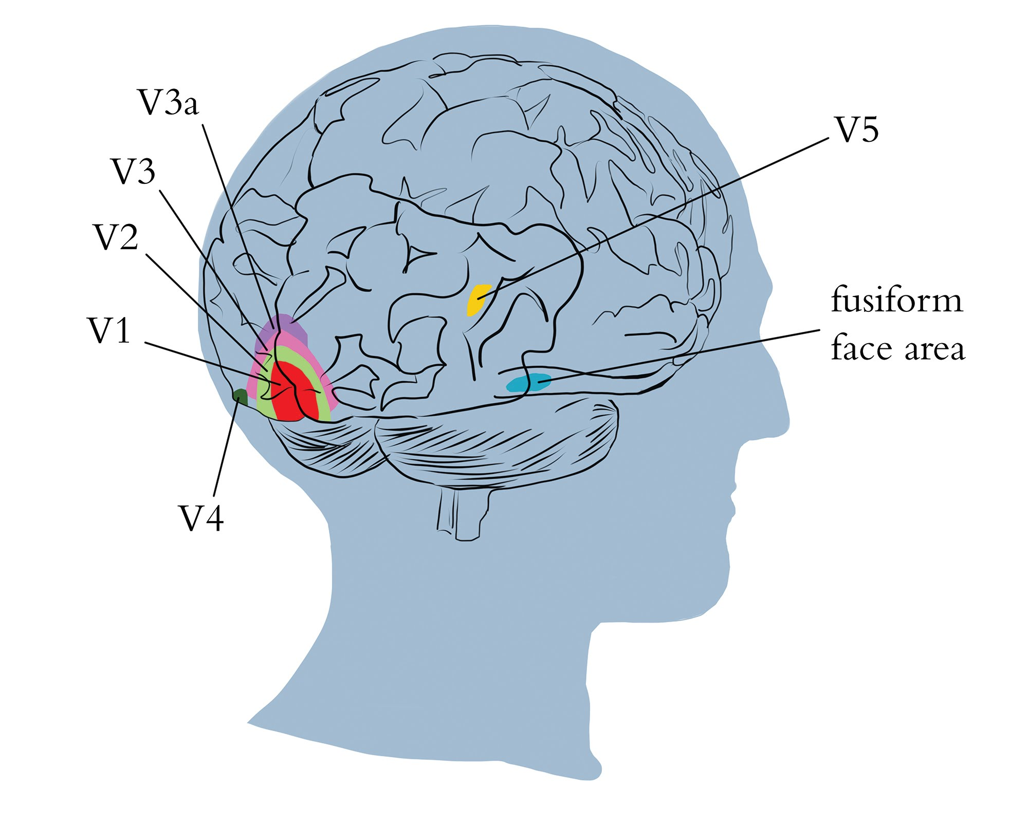

Slide 13
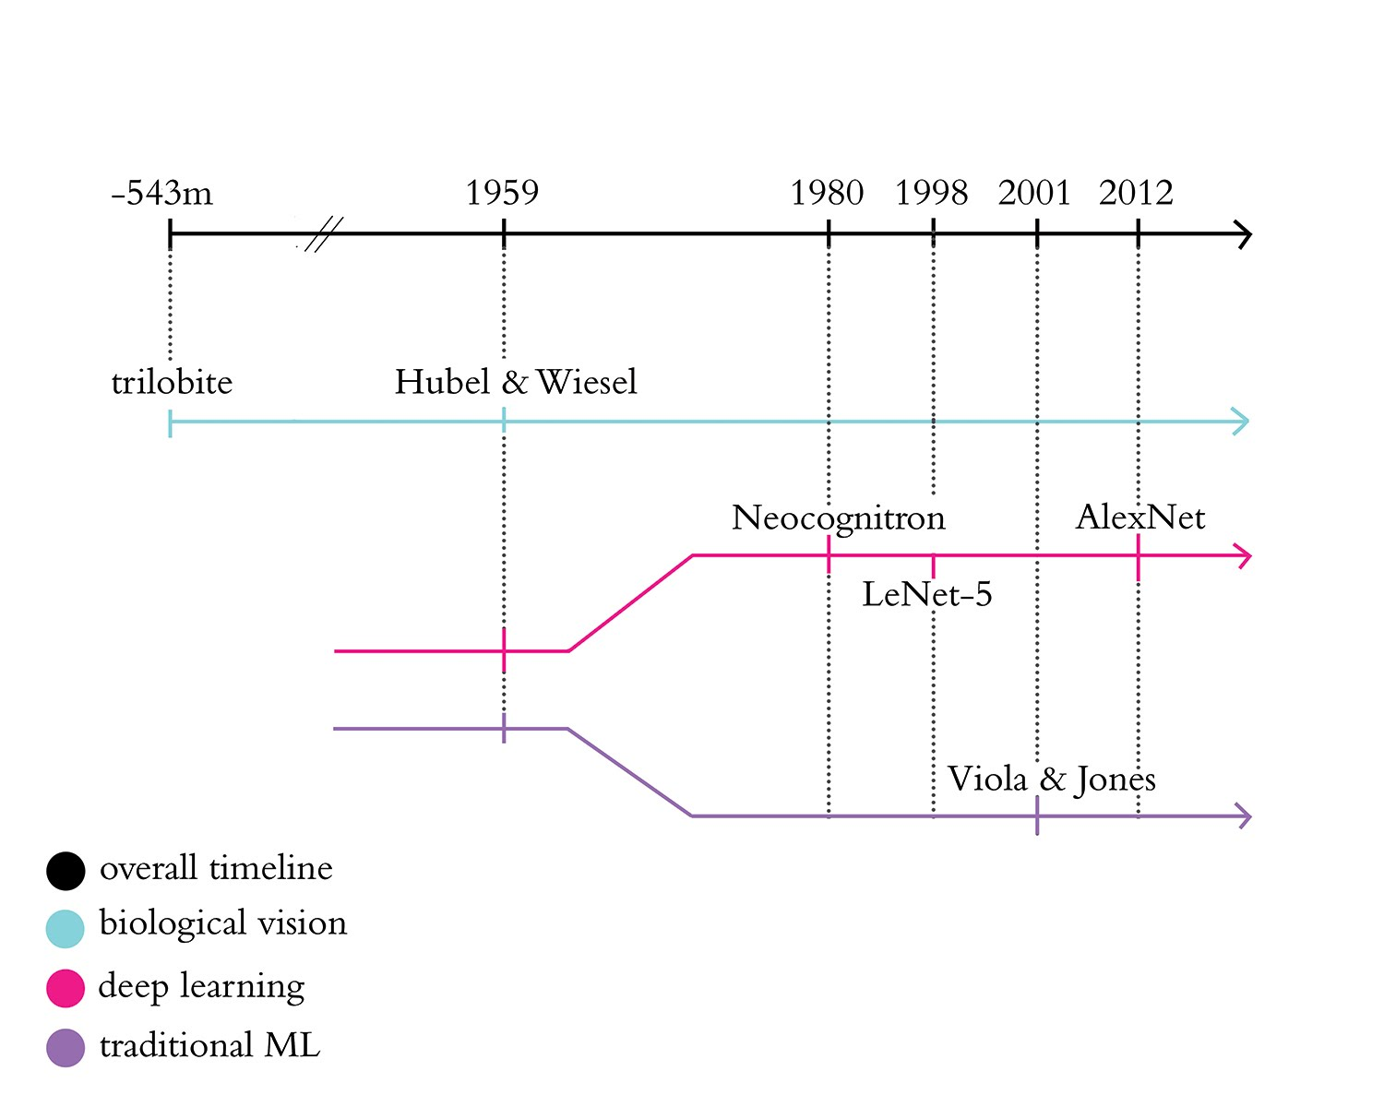

Slide 14
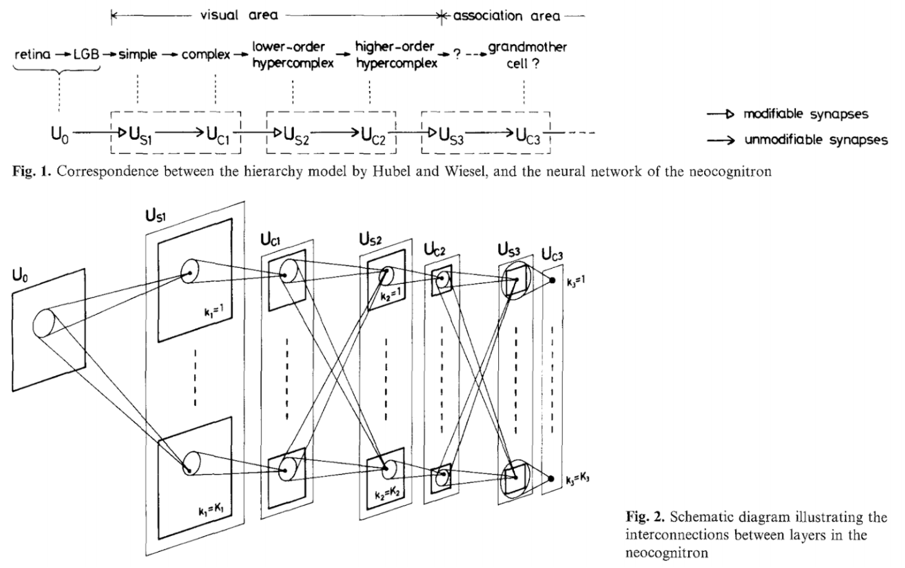
Fukushima (1980)

Slide 16
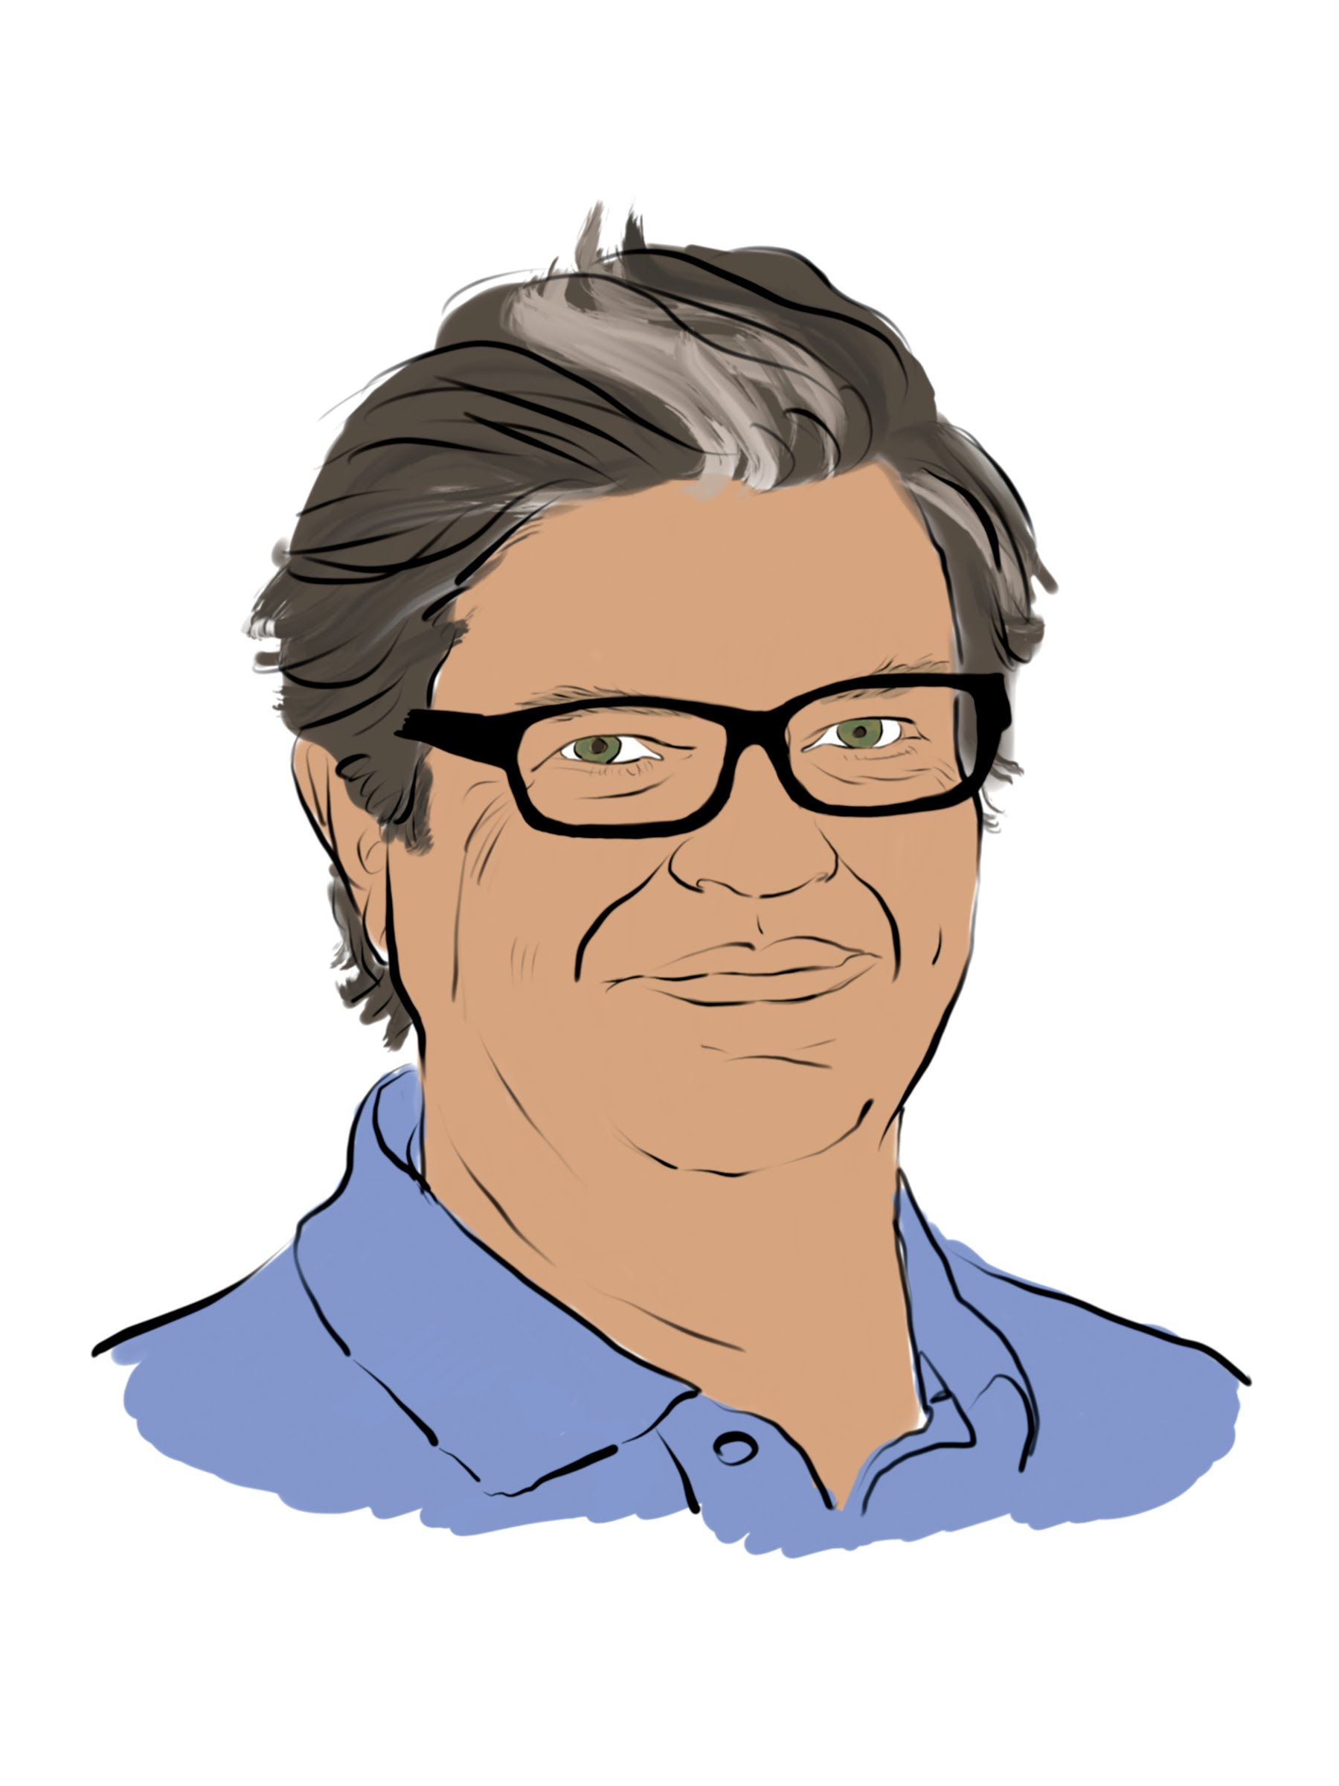
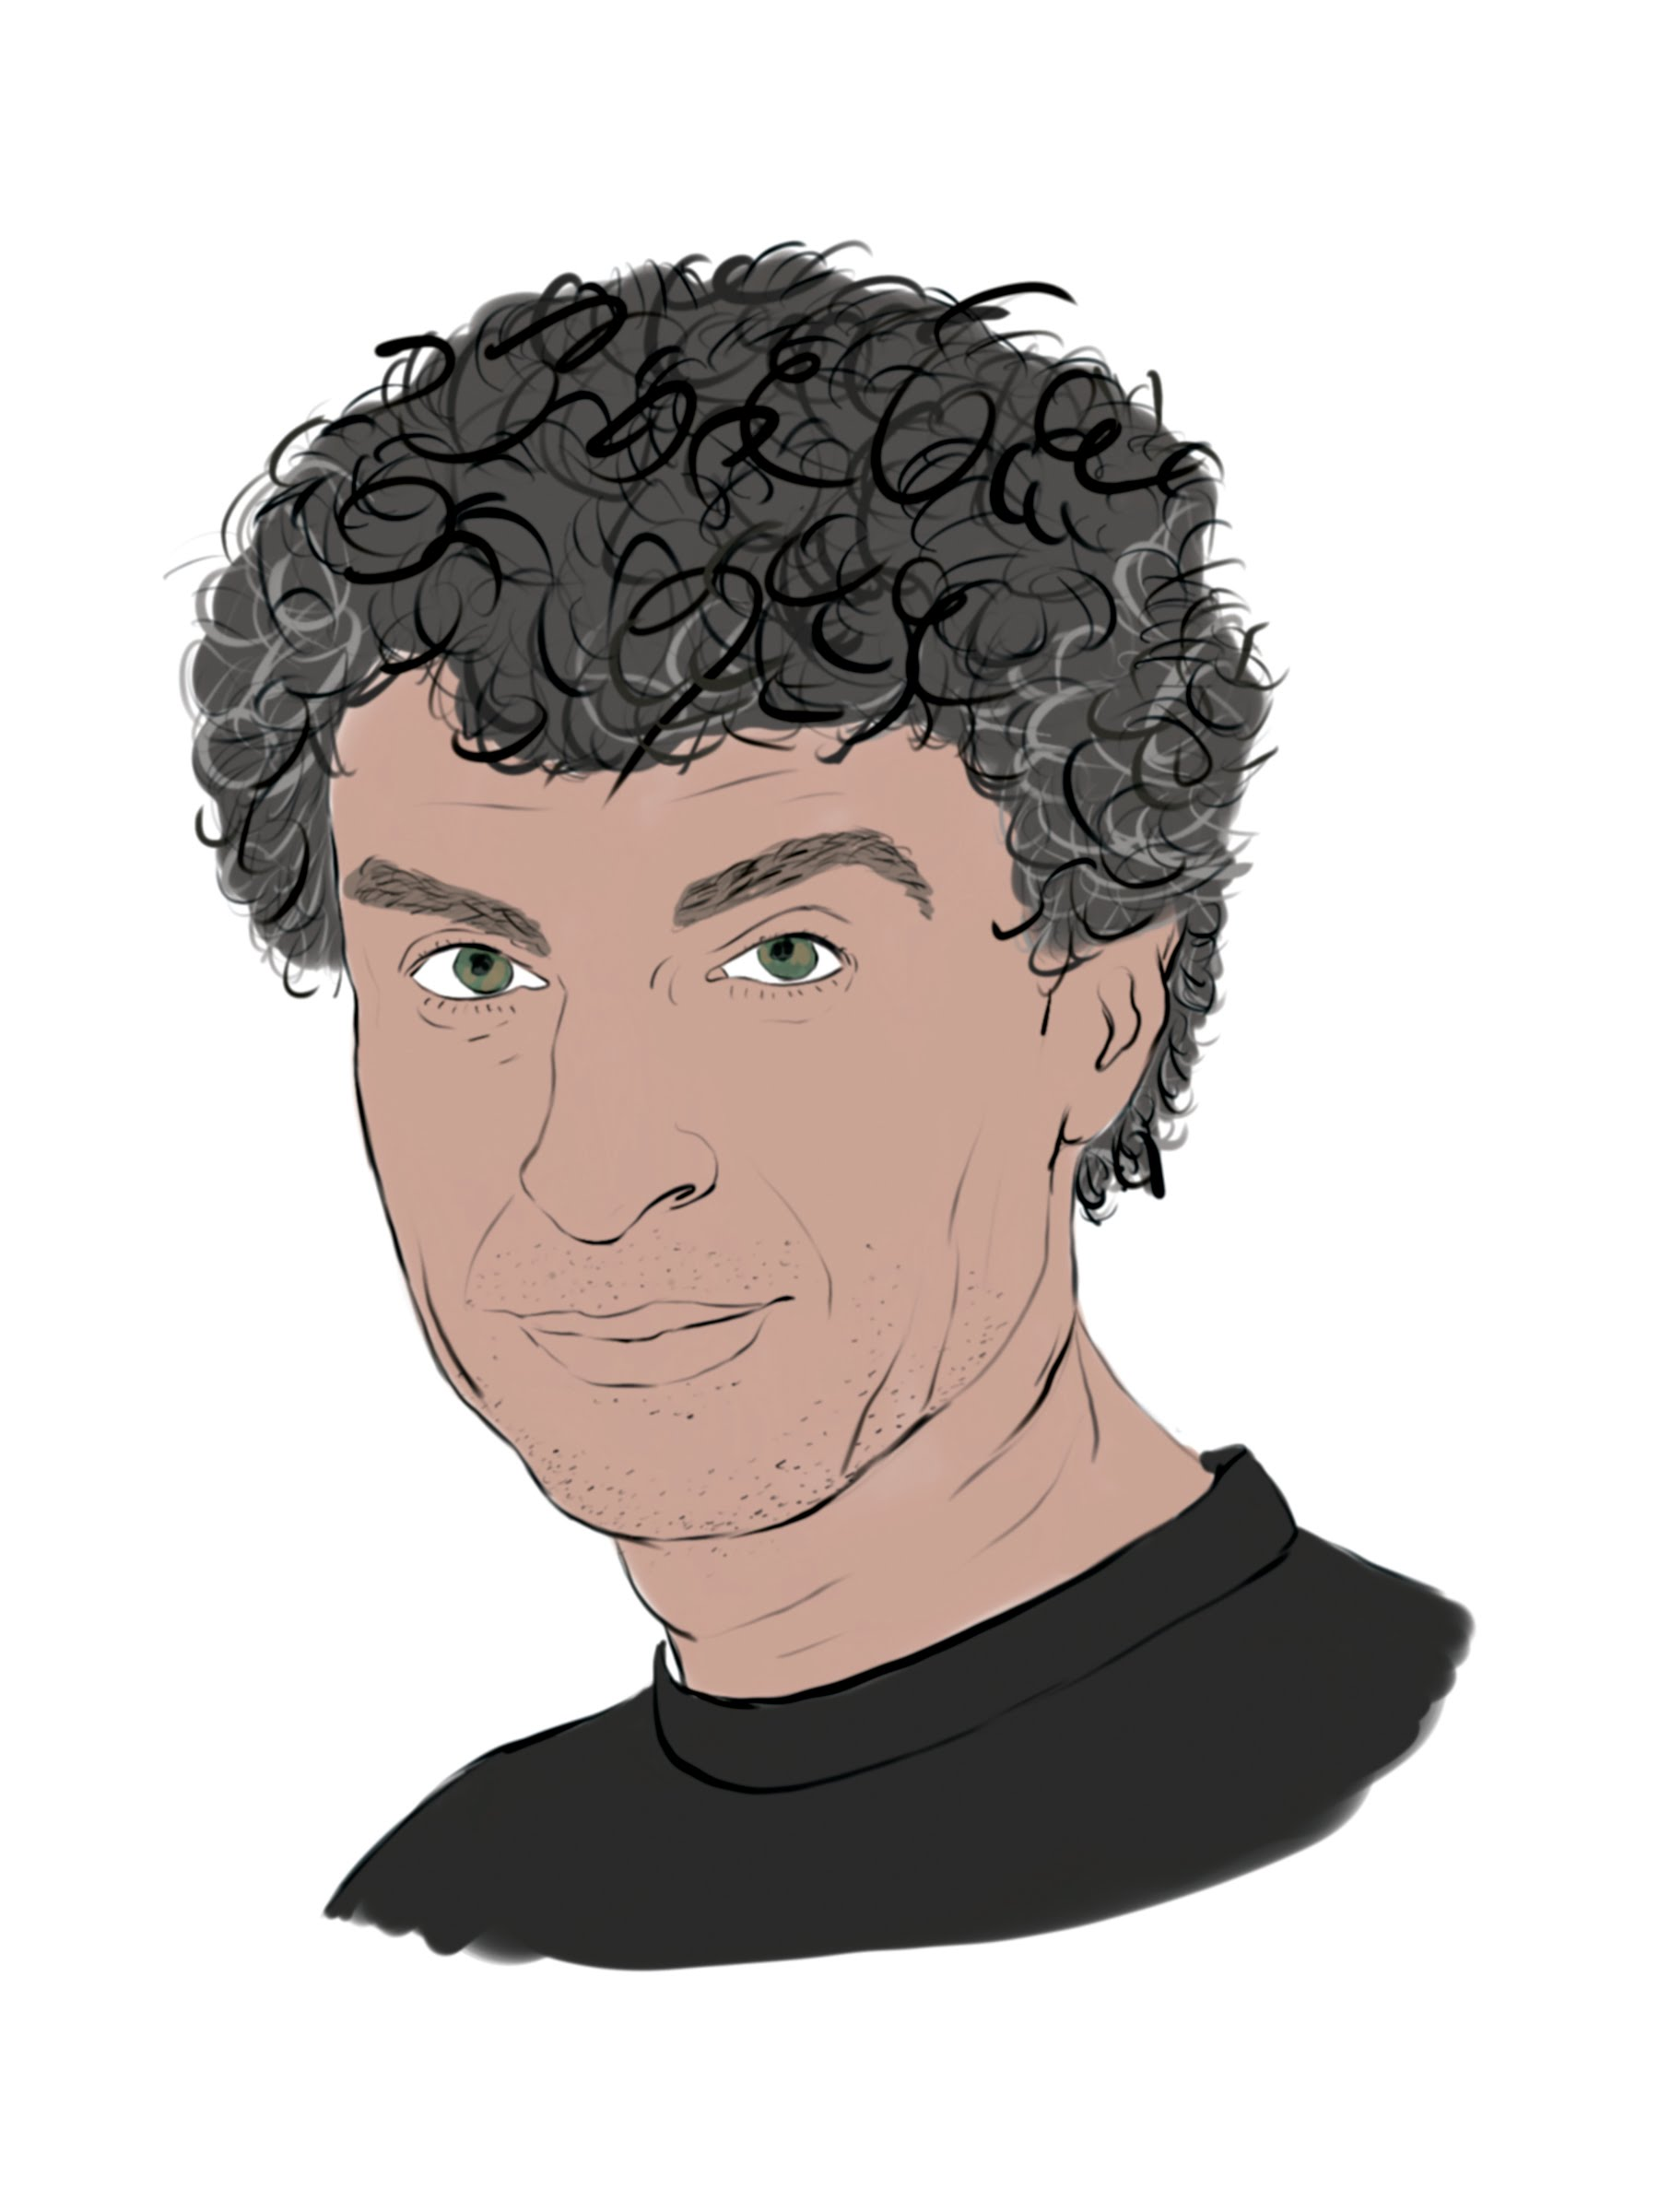
Yann LeCun and Yoshua Bengio

Slide 17
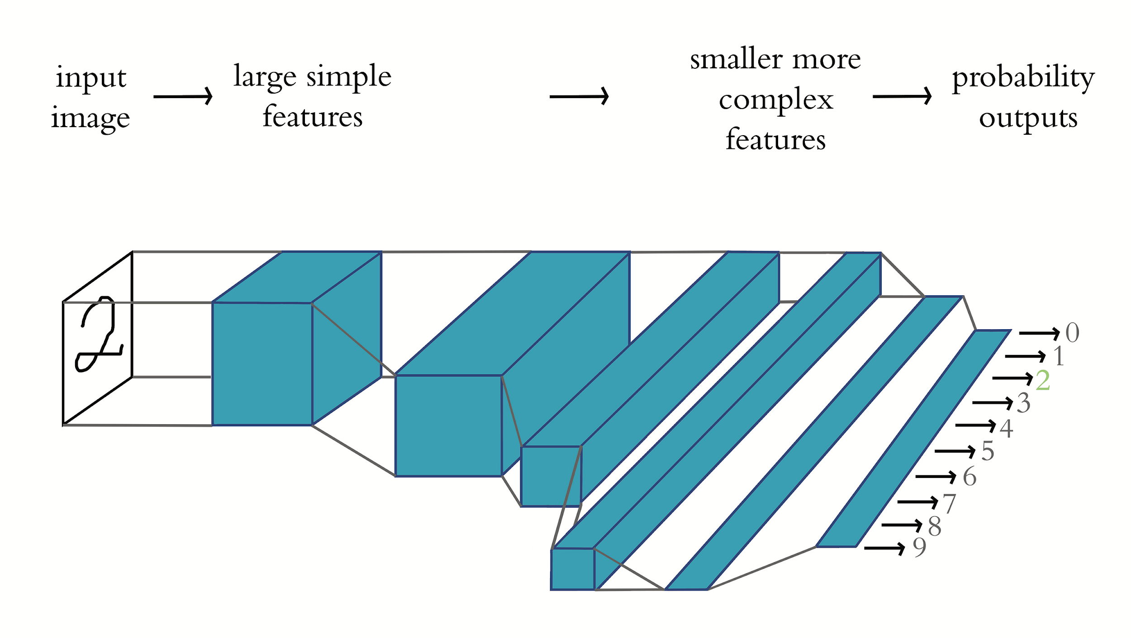
LeNet-5 (LeCun et al., 1998)

Slide 18
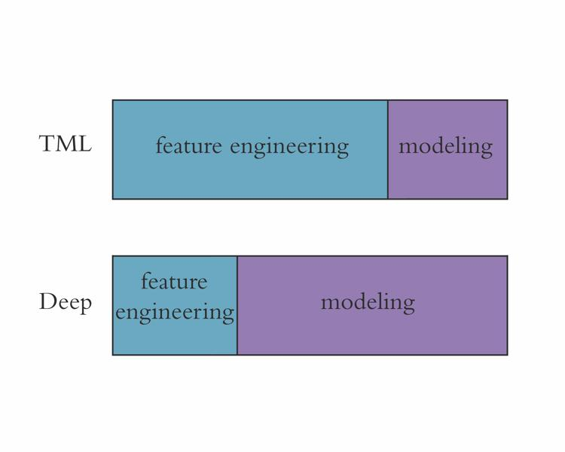

Slide 20
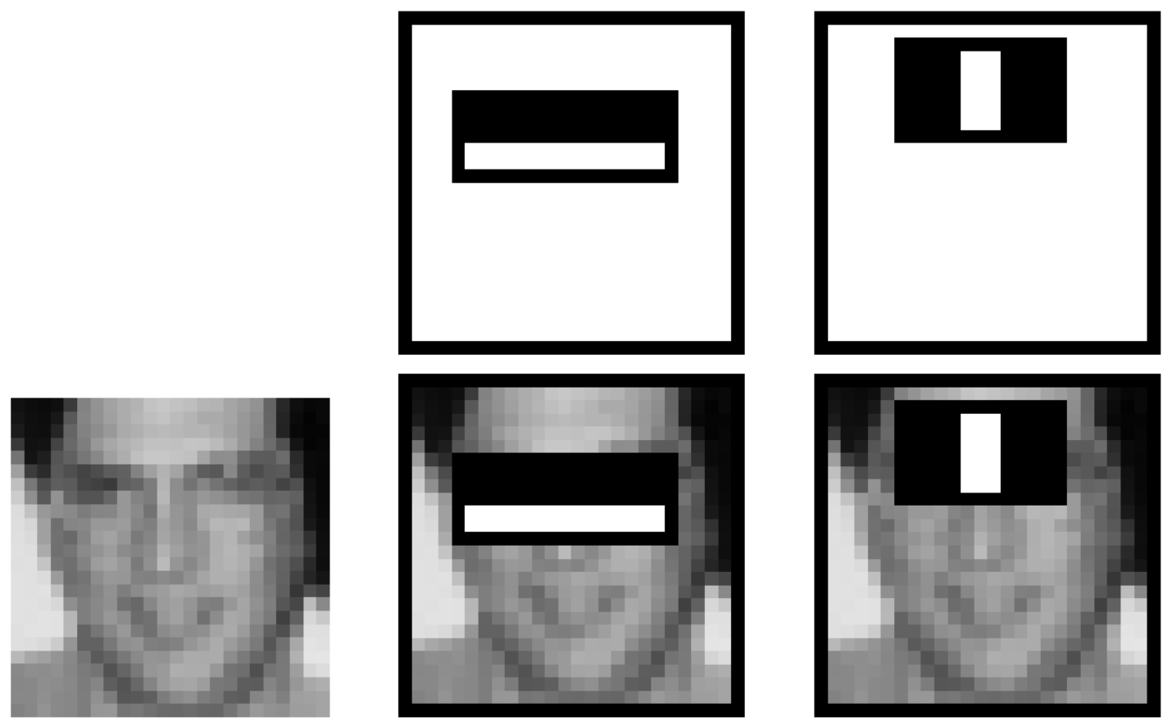
Viola & Jones (2001)

Slide 22

Fei-Fei Li

Slide 23
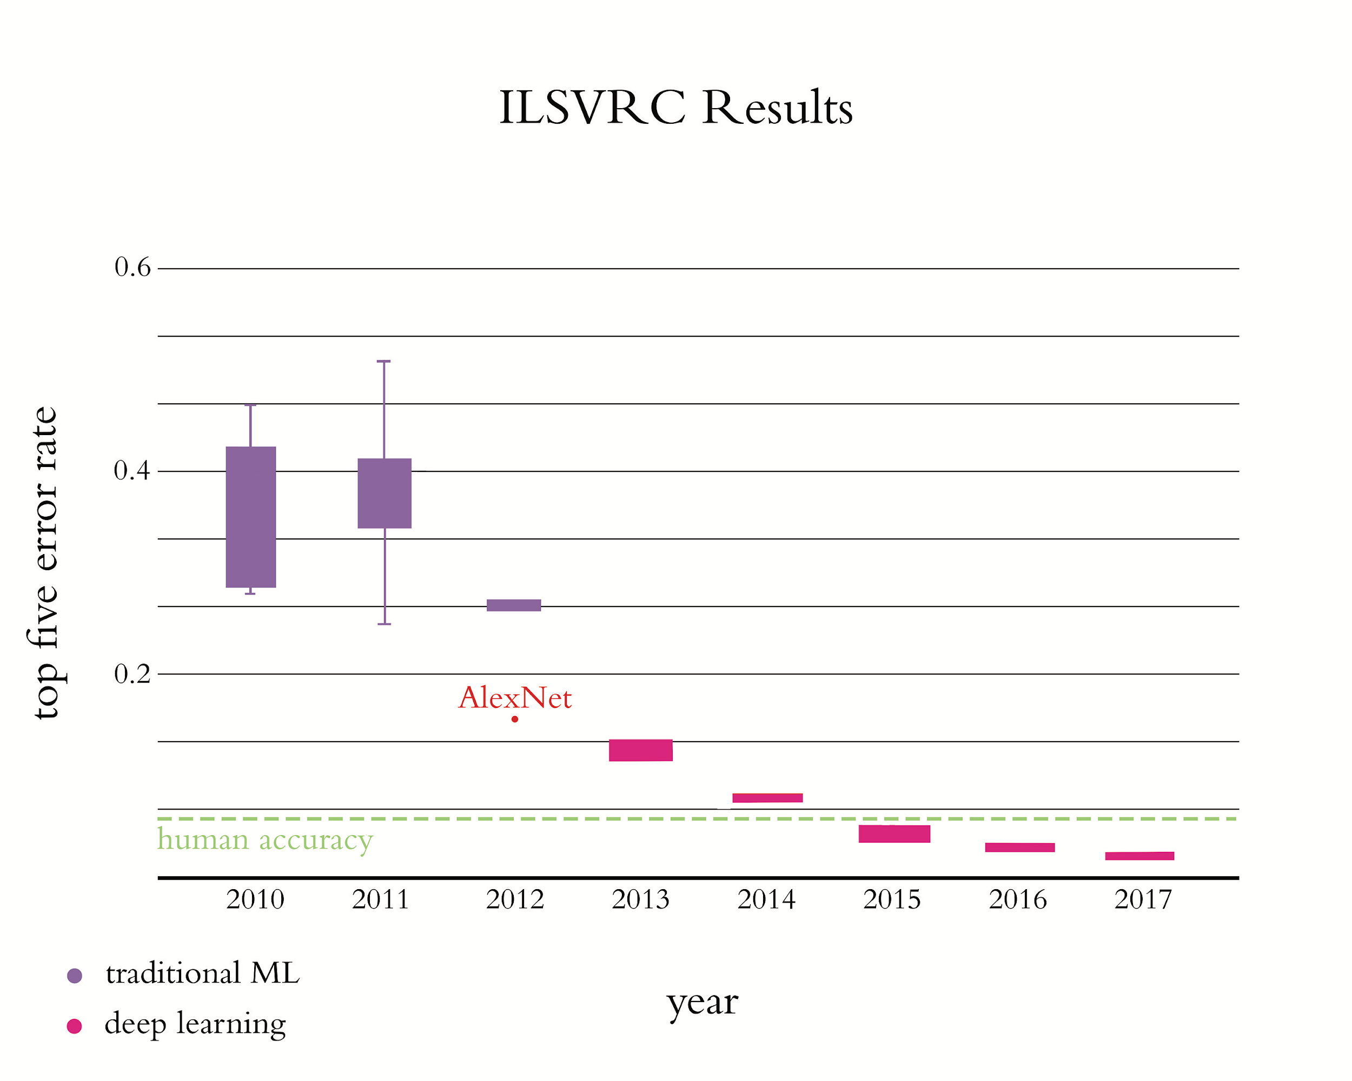

Slide 24
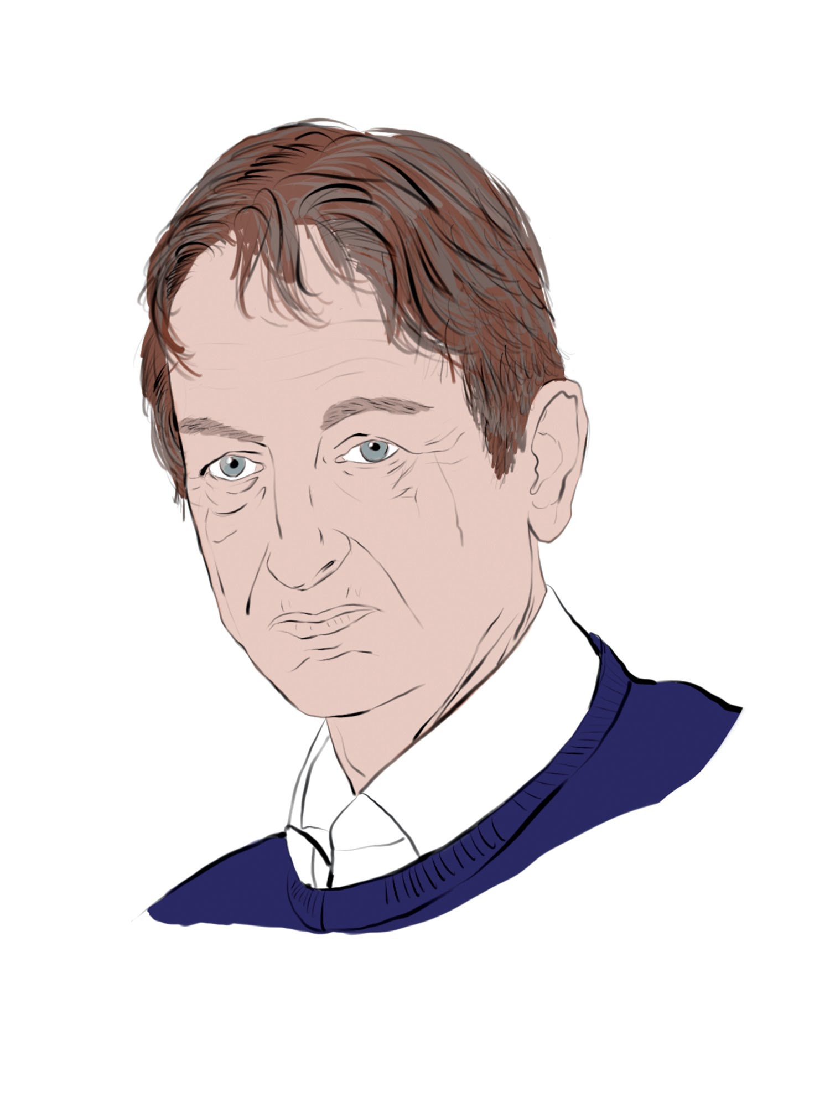
Geoff Hinton

Slide 25
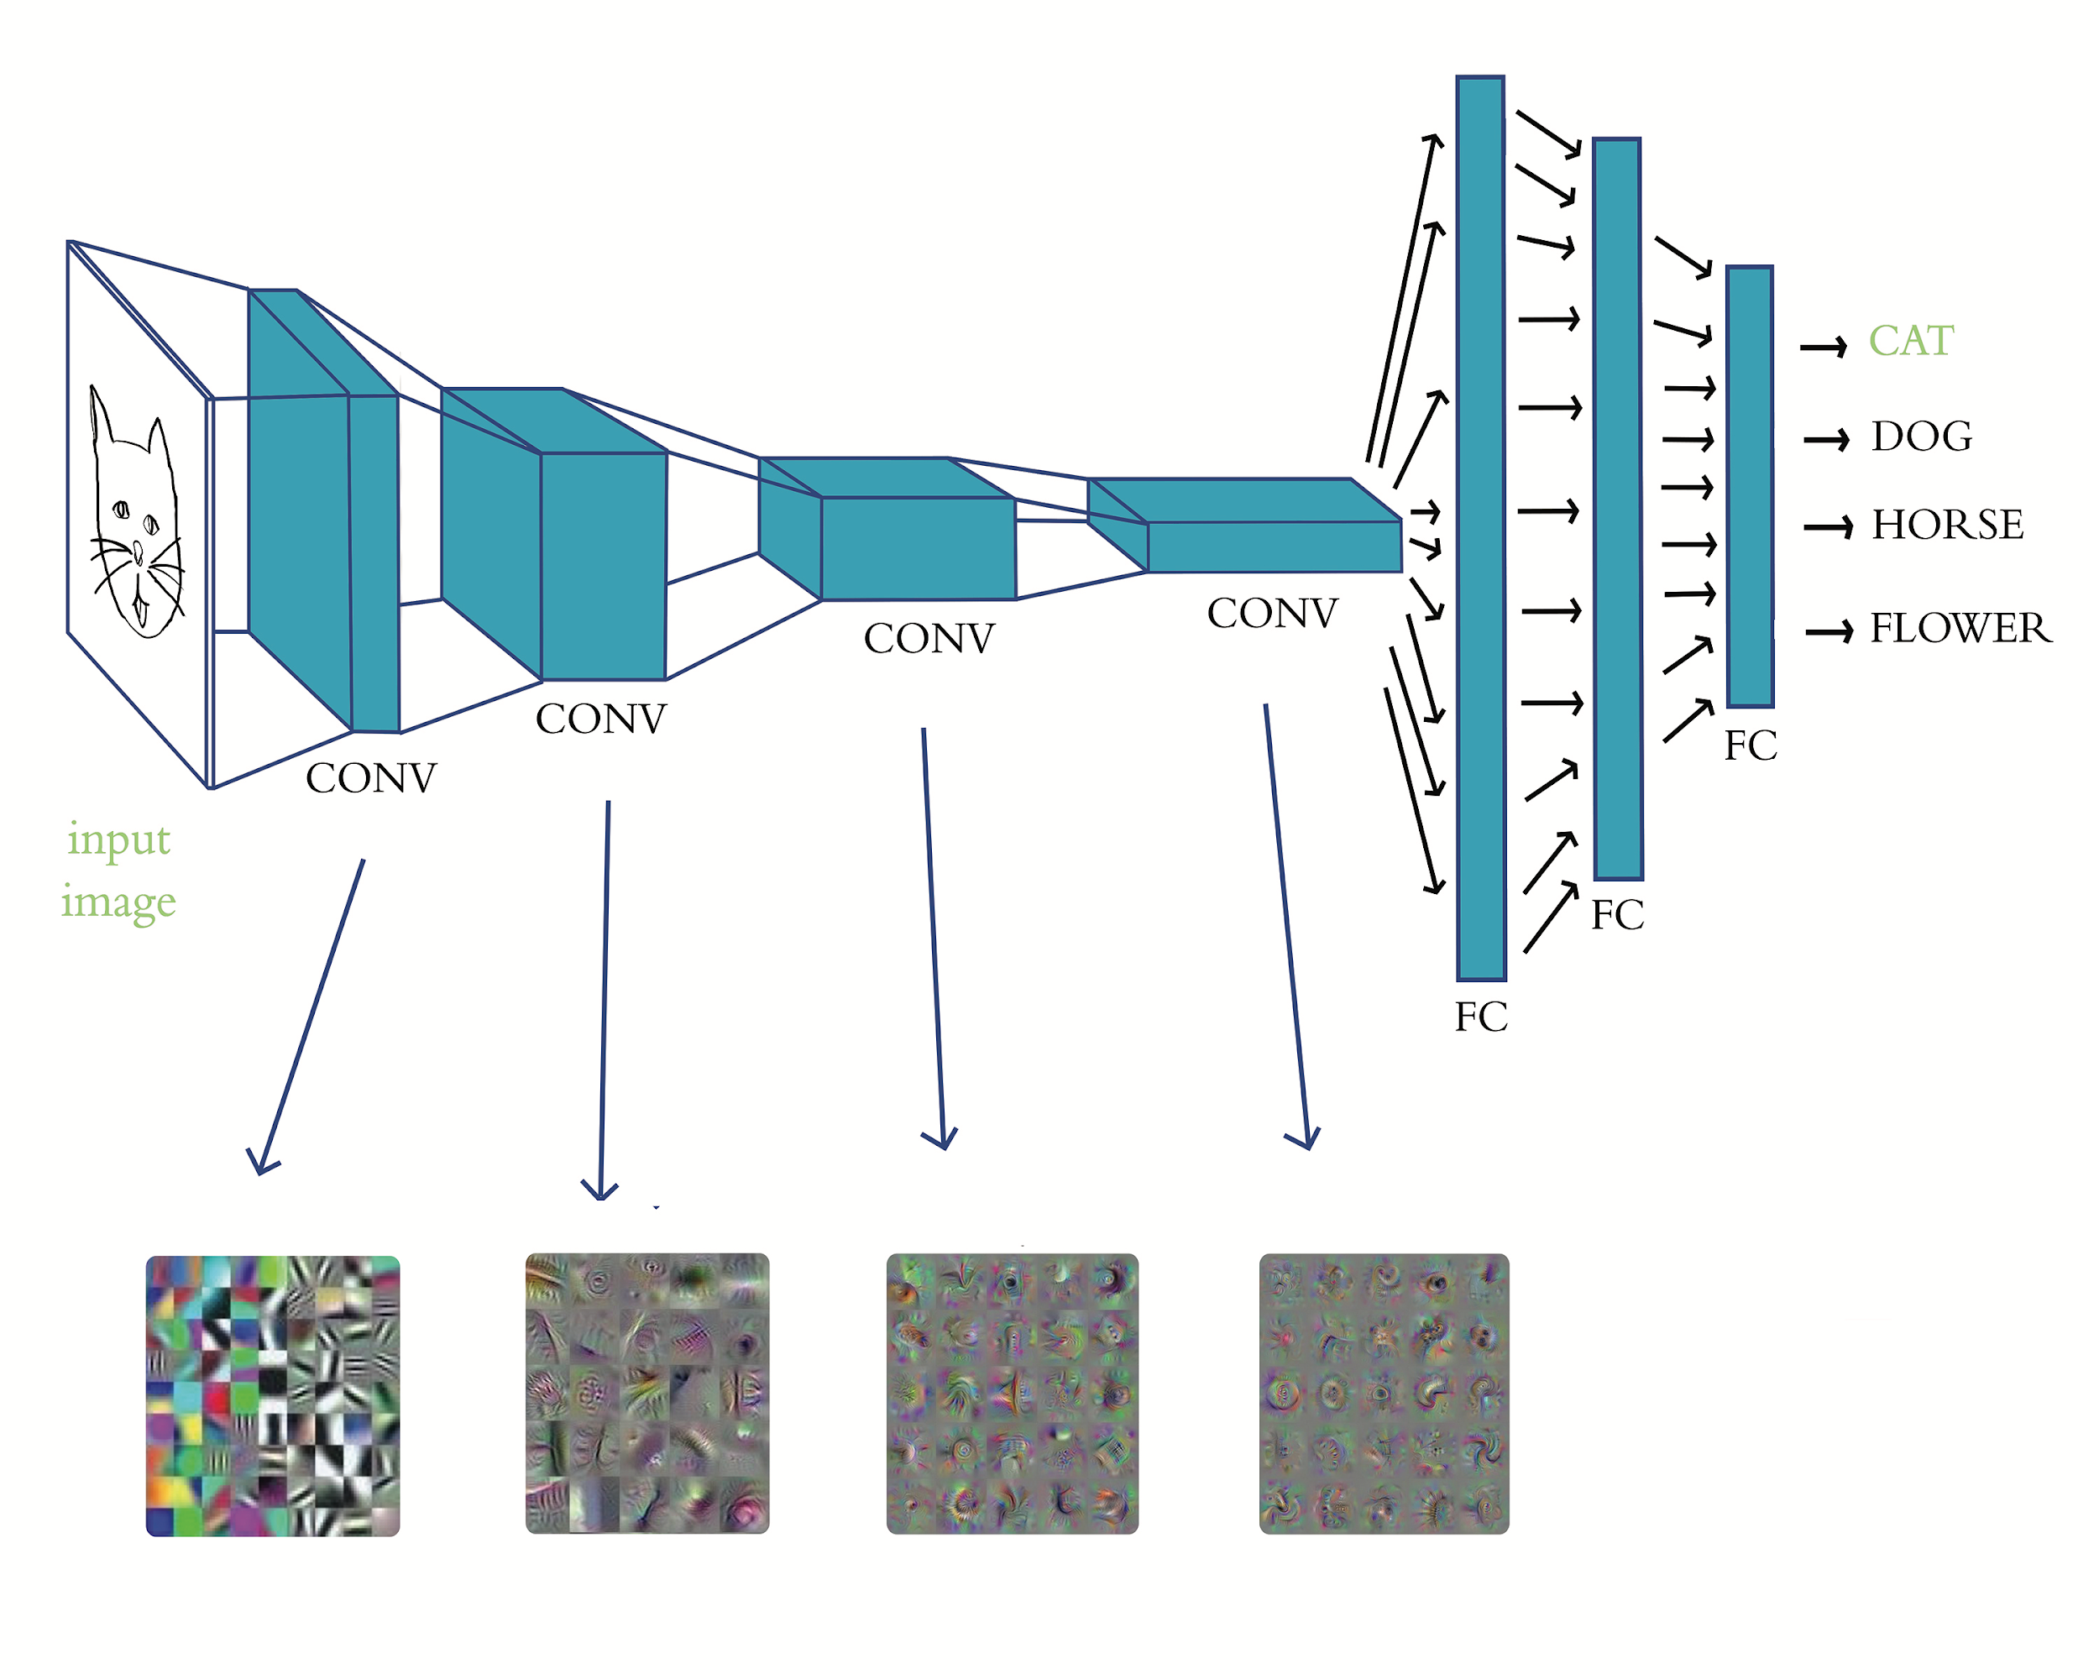
AlexNet (Krizhevsky et al., 2012)

Slide 26
Factors Behind AlexNet Tsunami
Data
Compute
Theoretical Advances

Slide 27
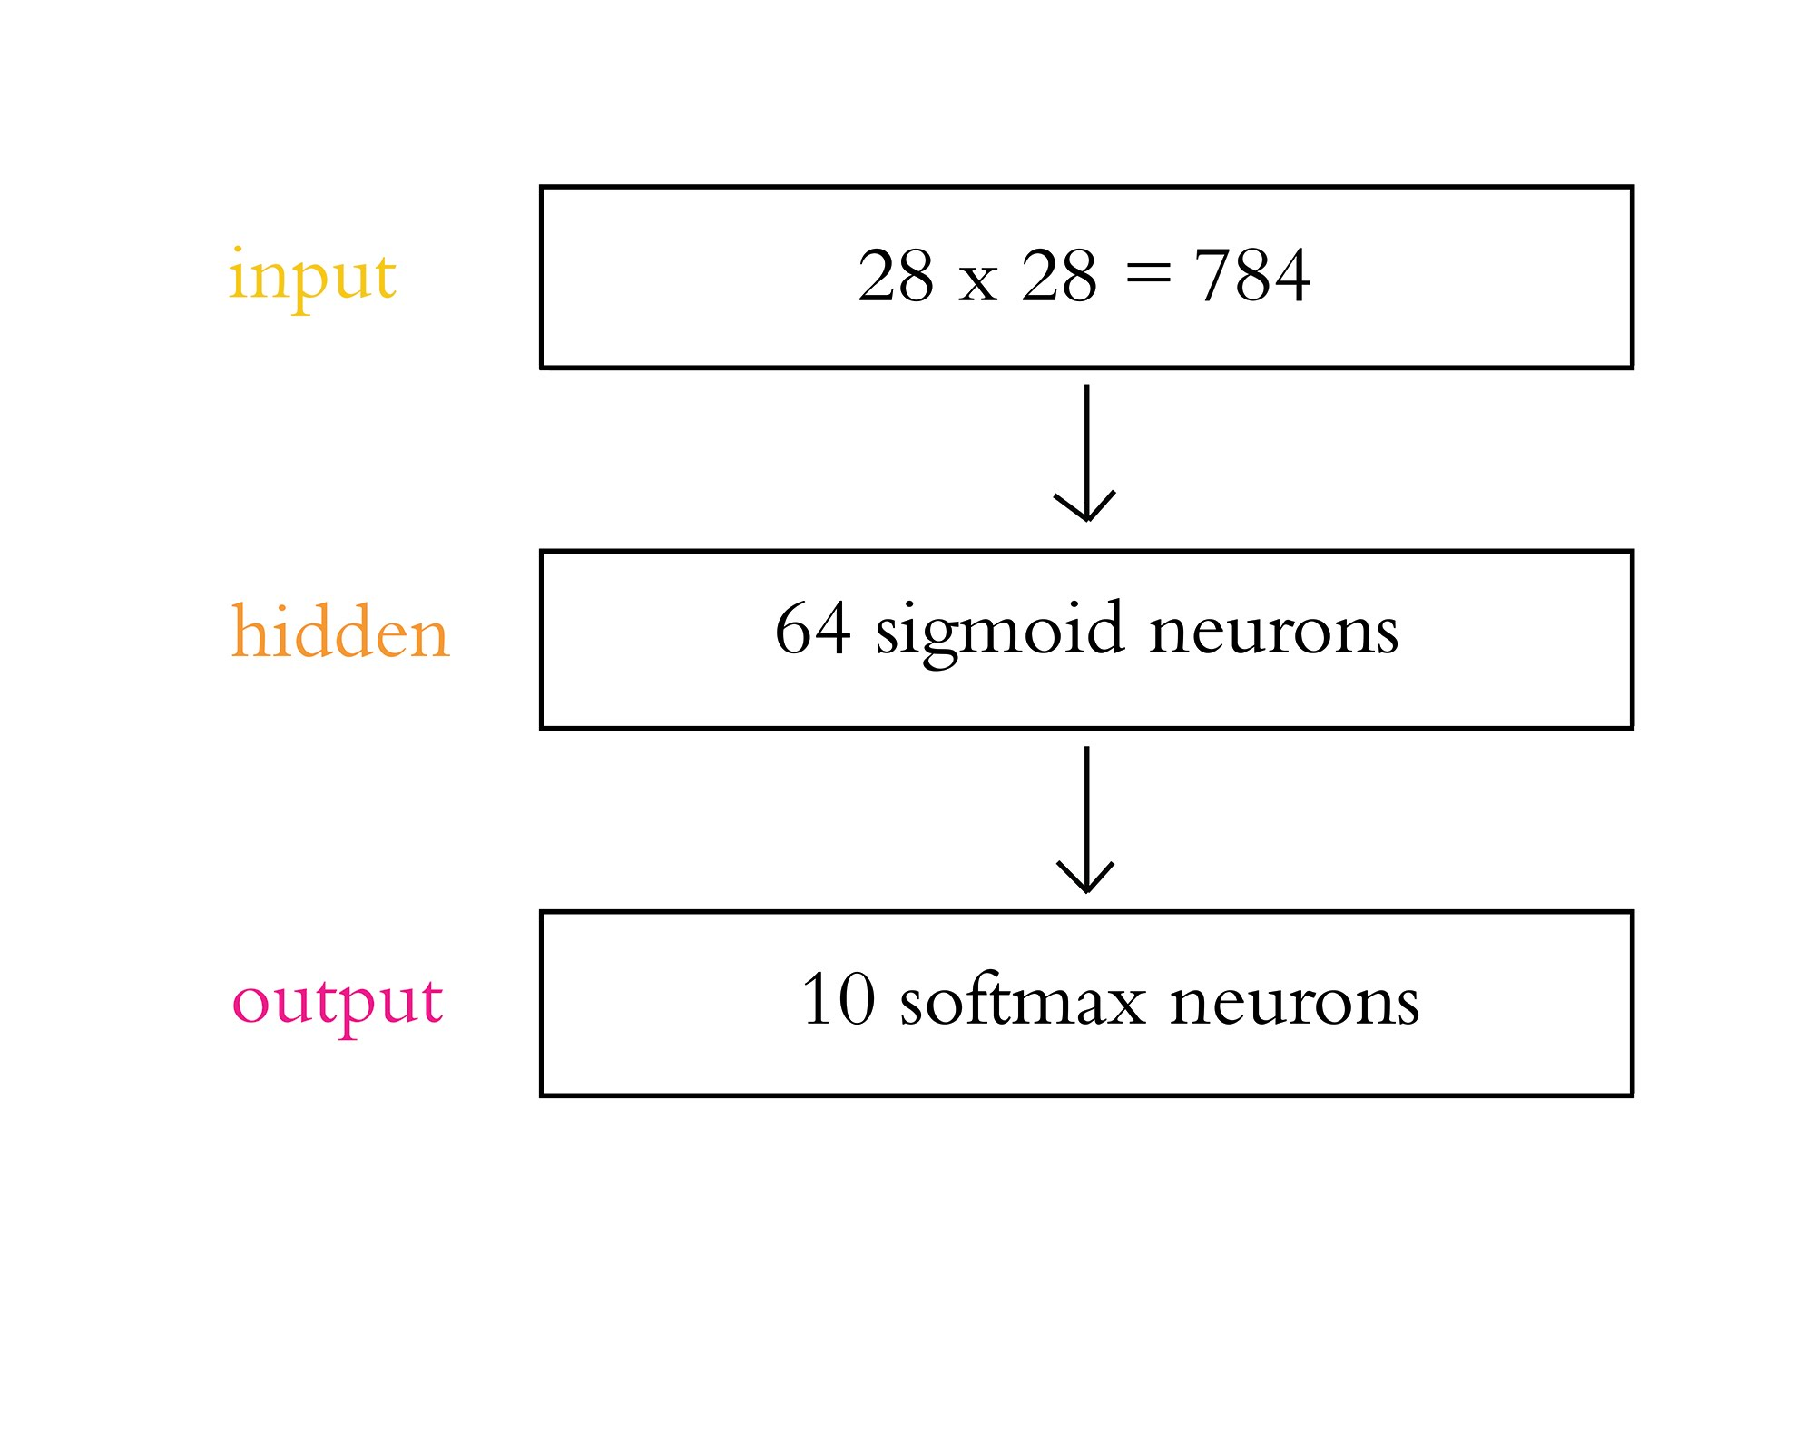
Chapter 5
Shallow Net Architecture:
A First Look

Slide 28
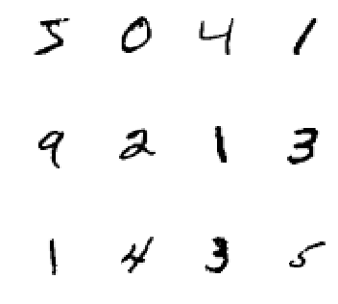
Sample MNIST Digits

Slide 29

Corinna Cortes

Slide 30
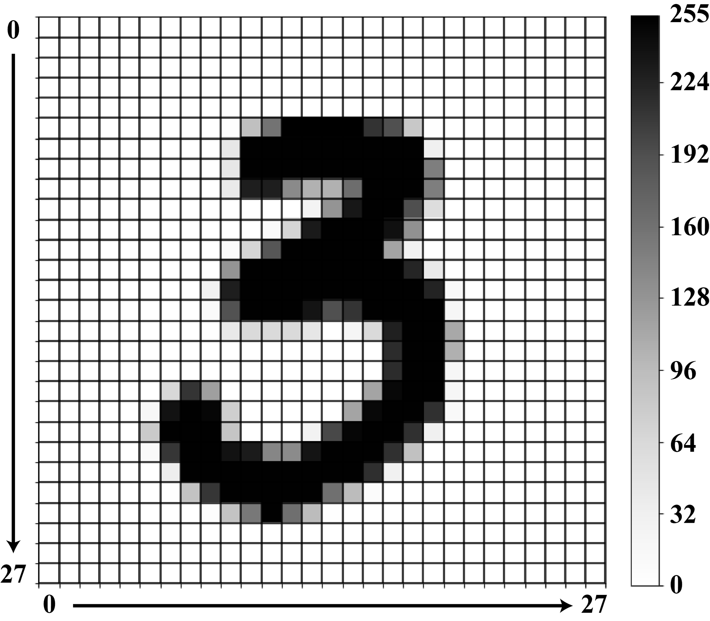

Slide 32
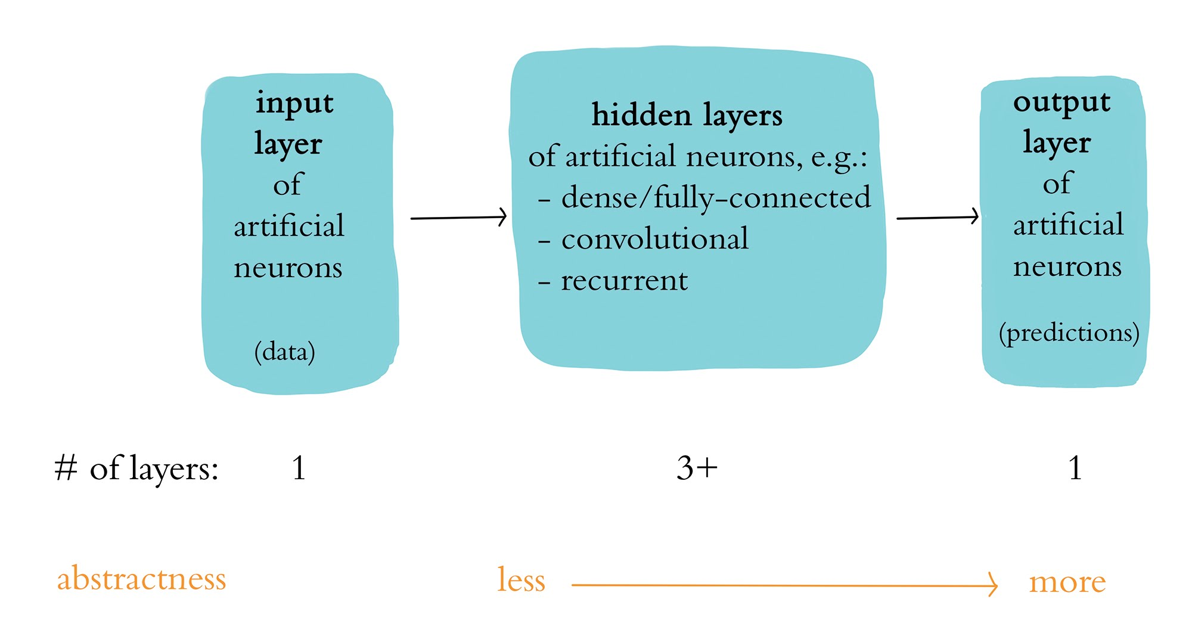
A Generalized Deep Learning Model

Slide 33
Applied Deep Learning
Module 2:
Chapter 6
Chapter 7

Slide 34
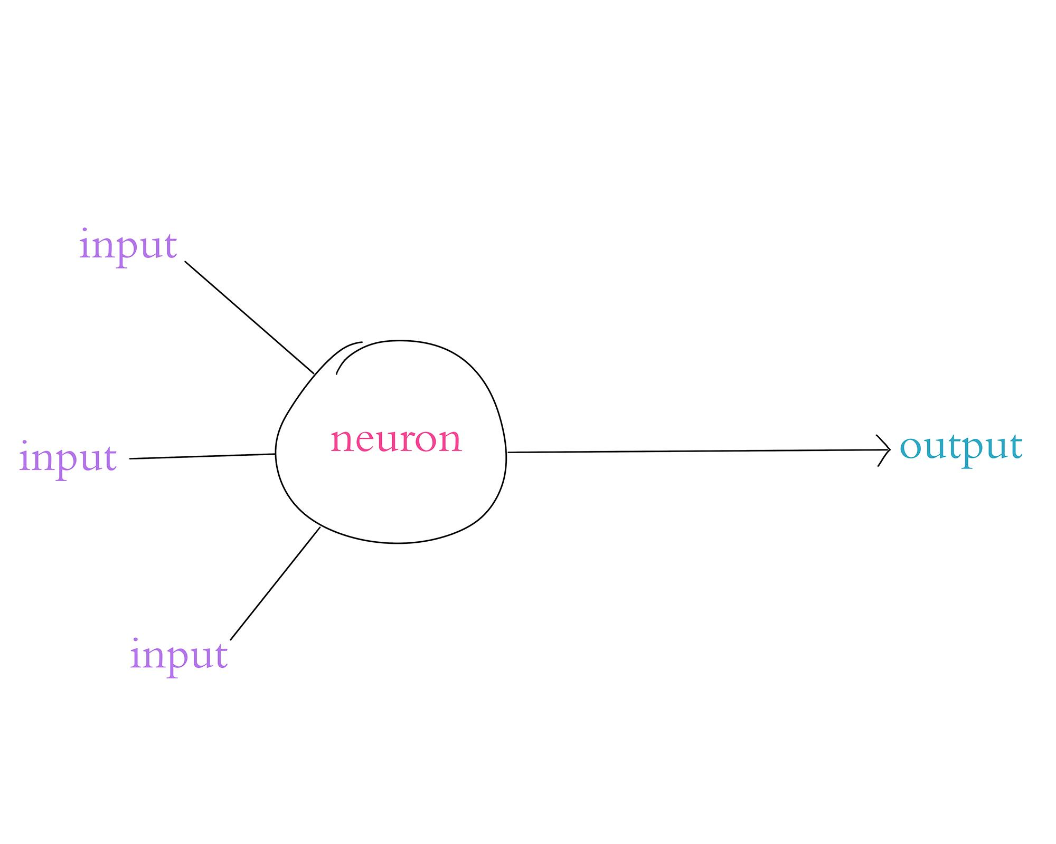
Chapter 6
Define & Build Artificial Neurons

Slide 35
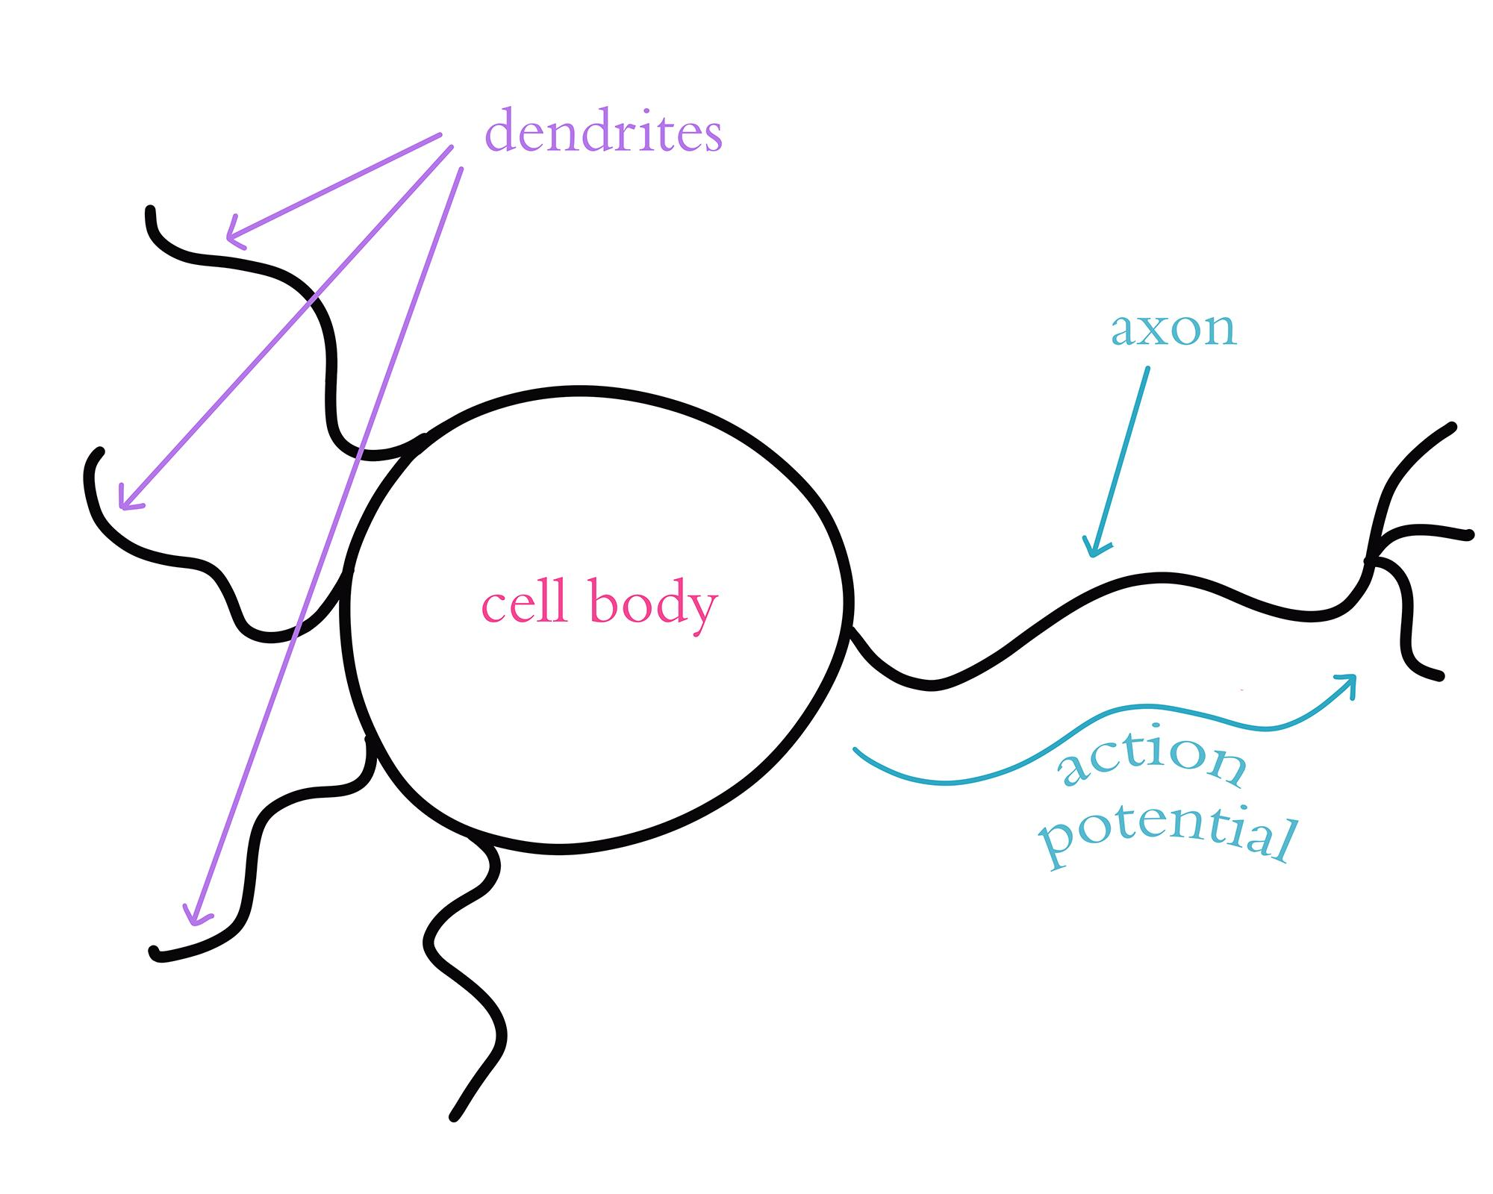
A Biological Neuron

Slide 36

Frank Rosenblatt

Slide 37
The Perceptron (Rosenblatt, 1958)

Slide 38
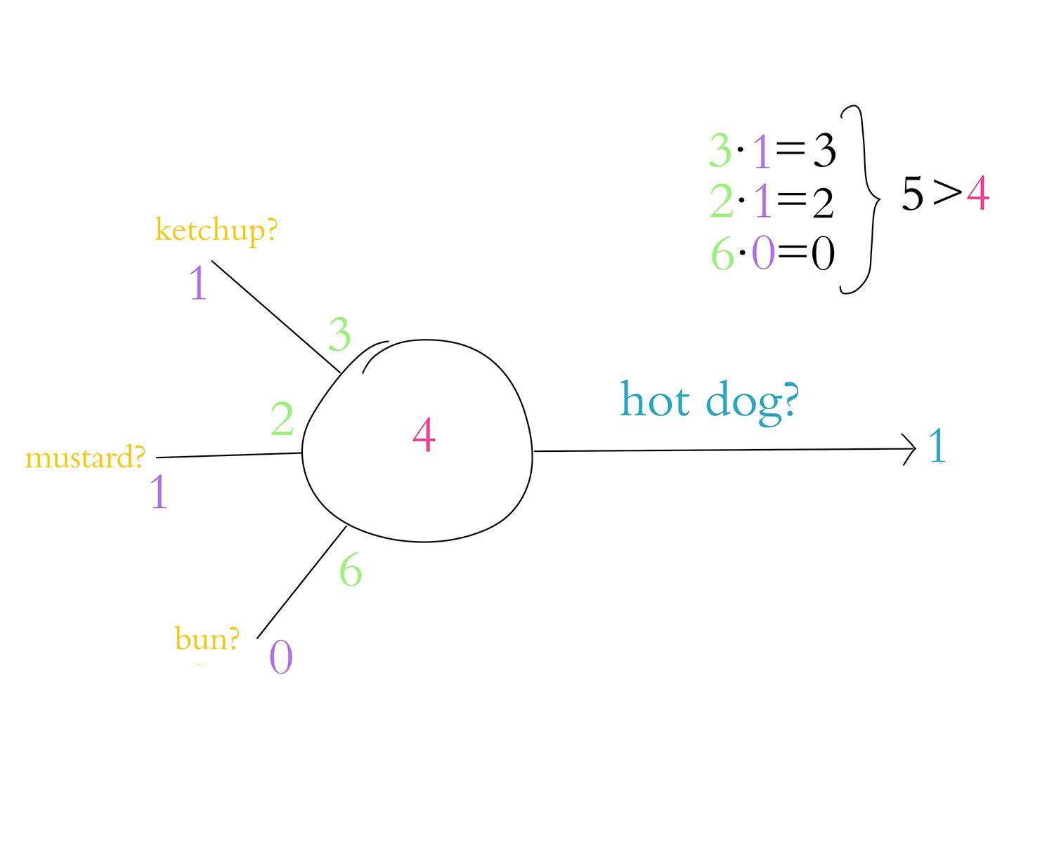

Slide 39
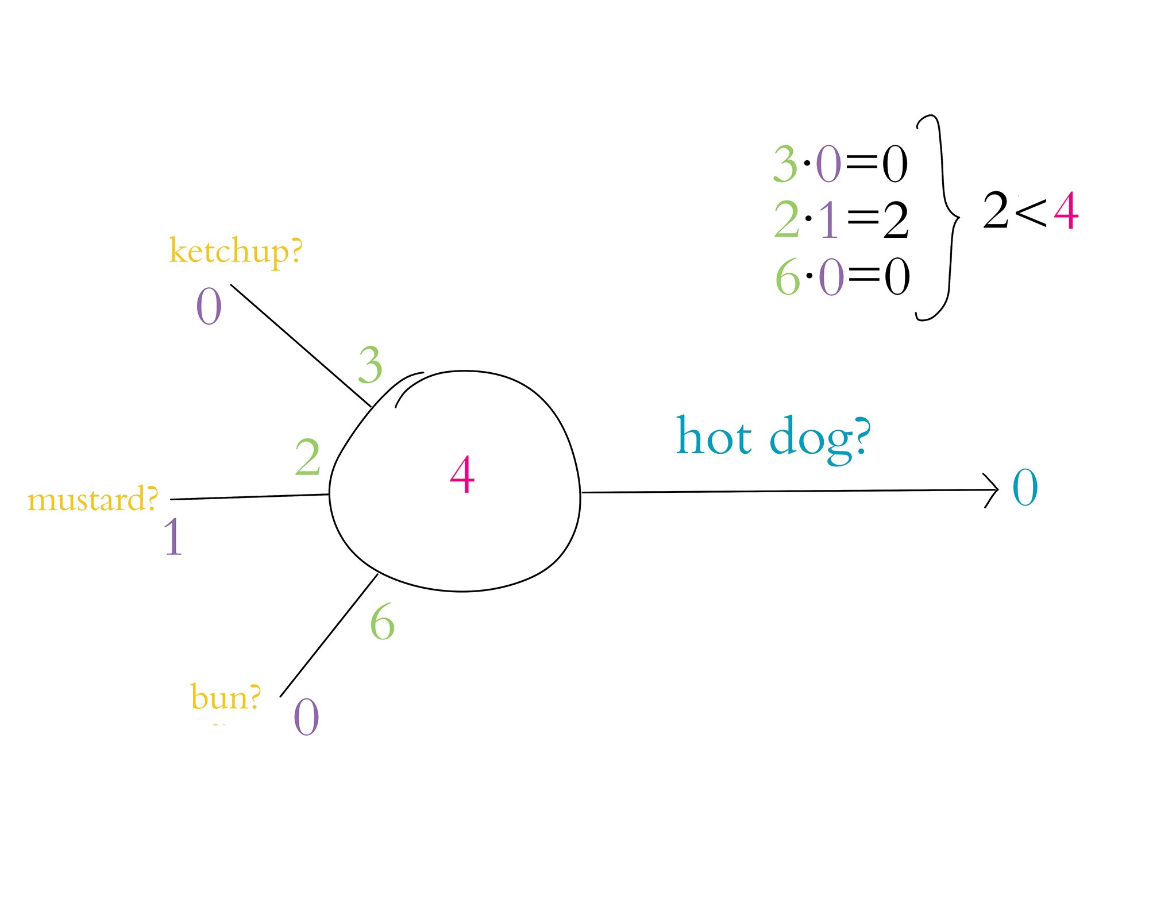

Slide 40
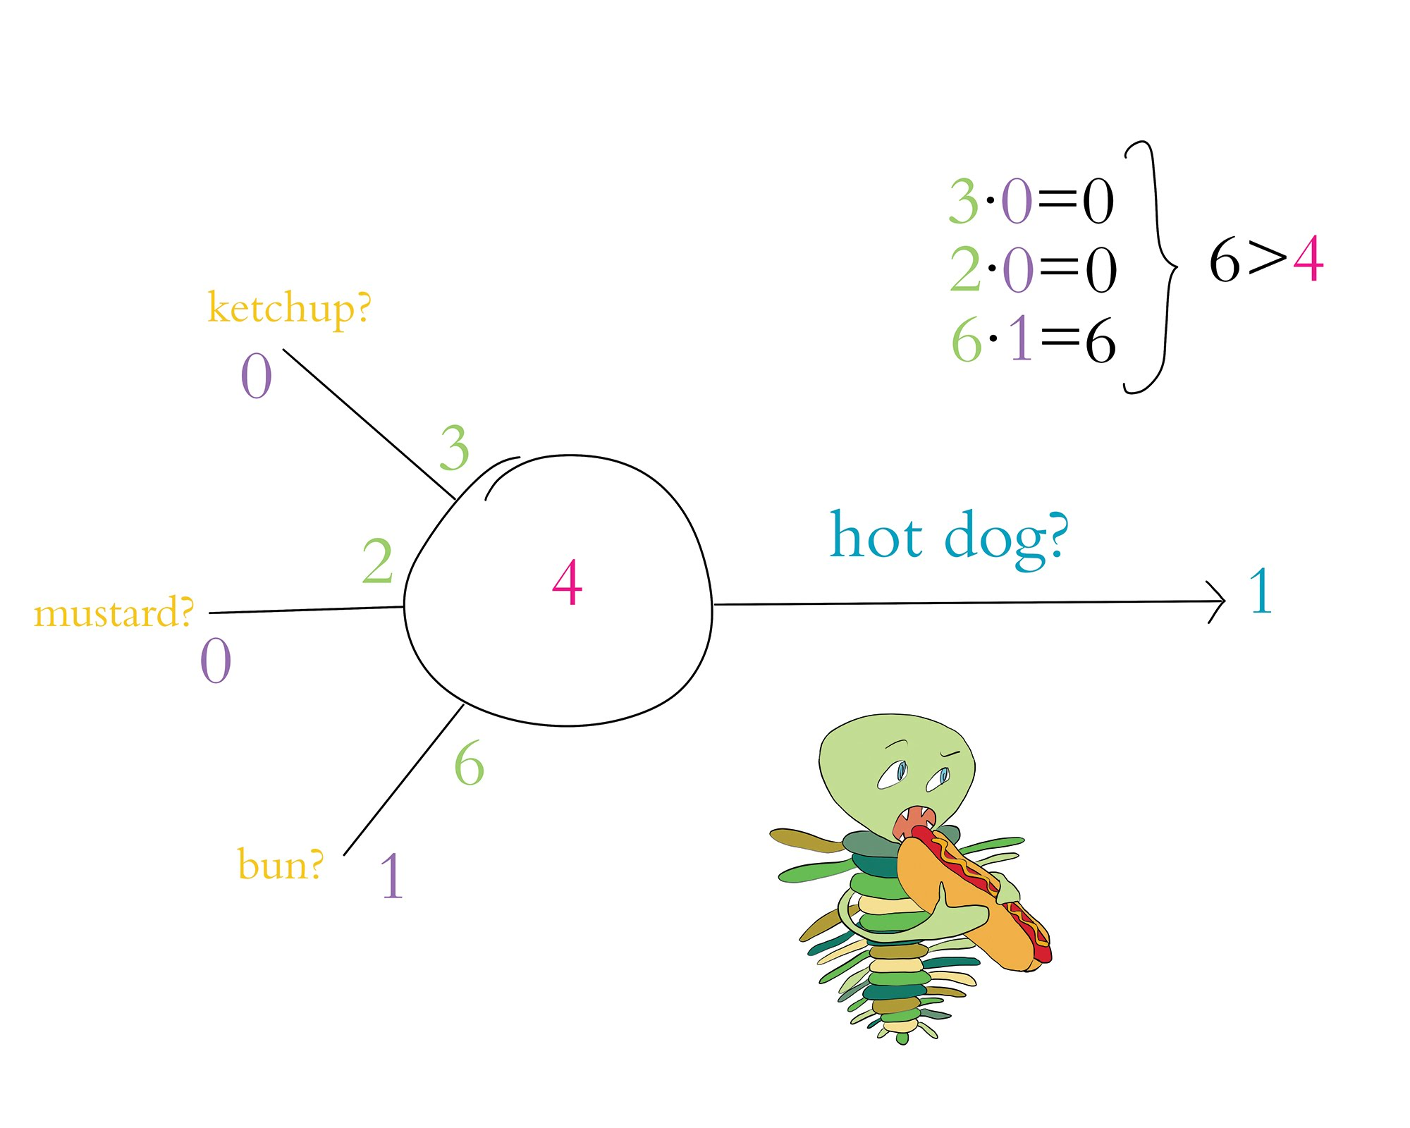

Slide 41
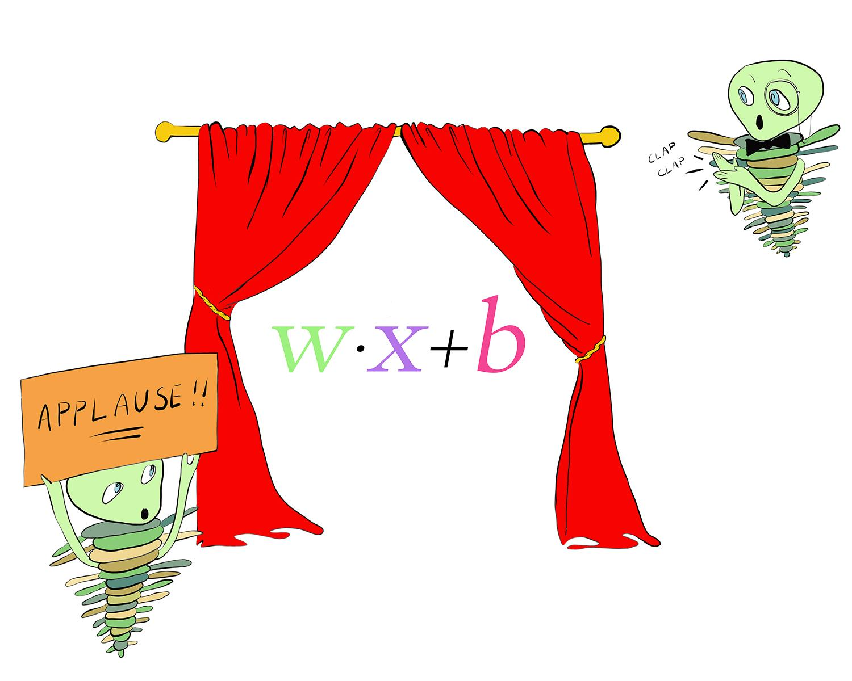

Slide 42
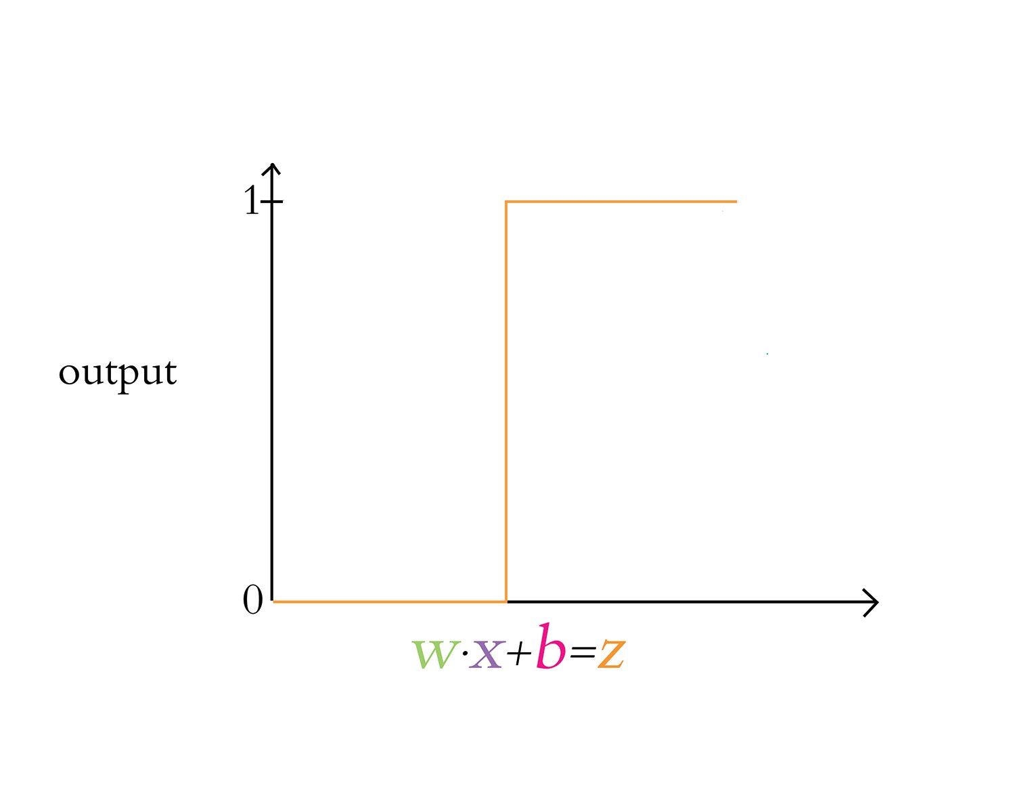

Slide 43
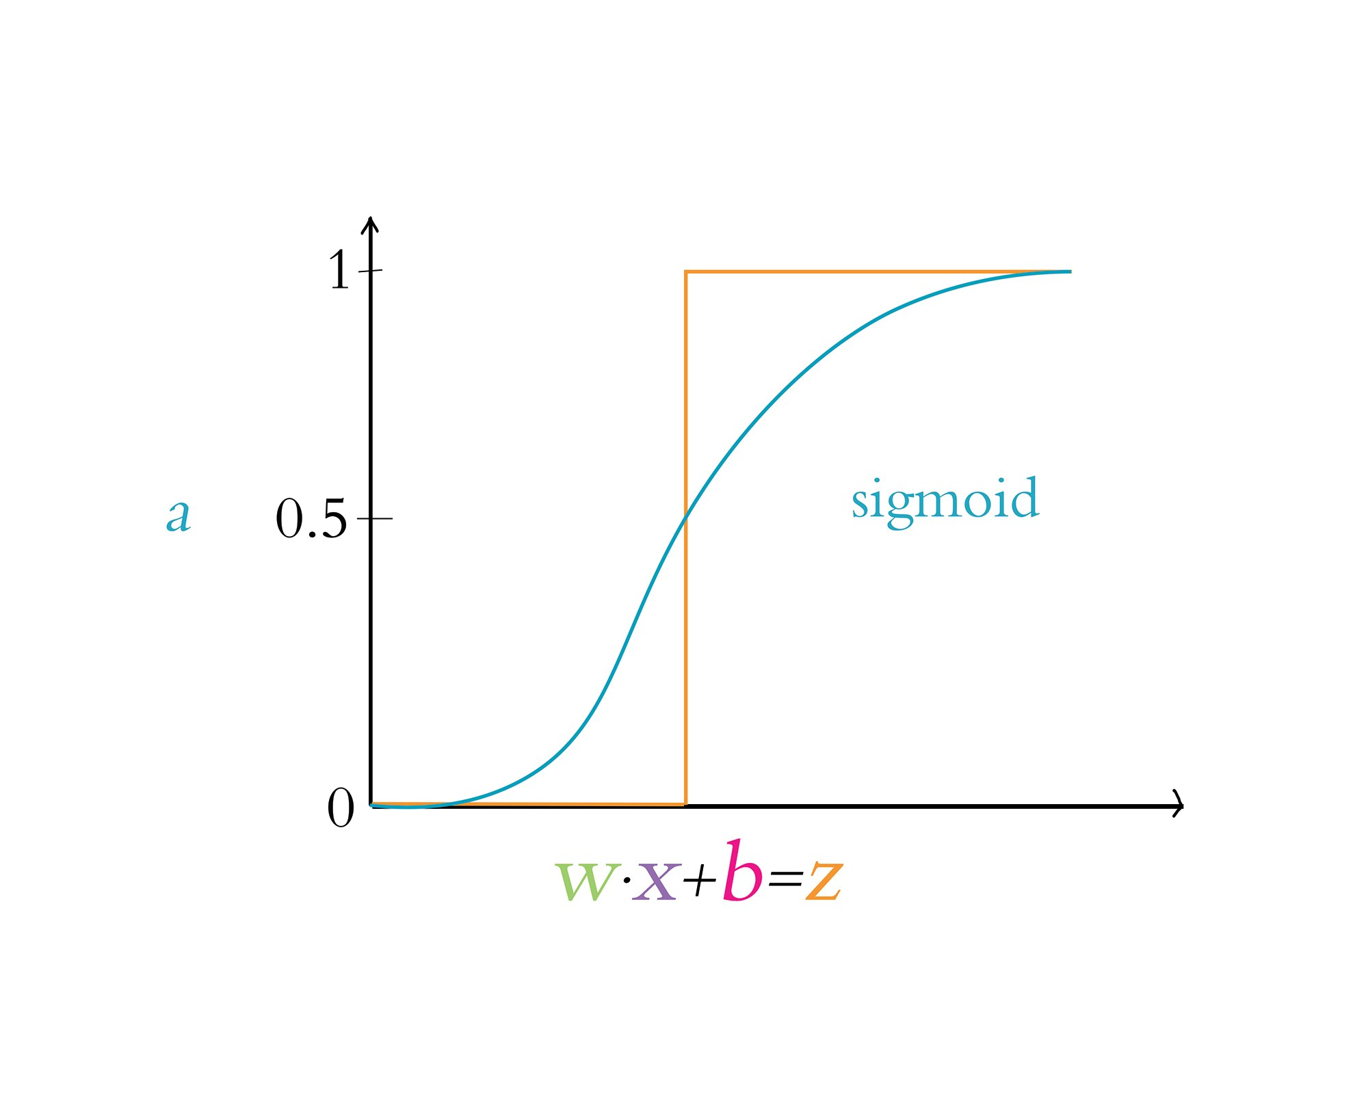

Slide 44
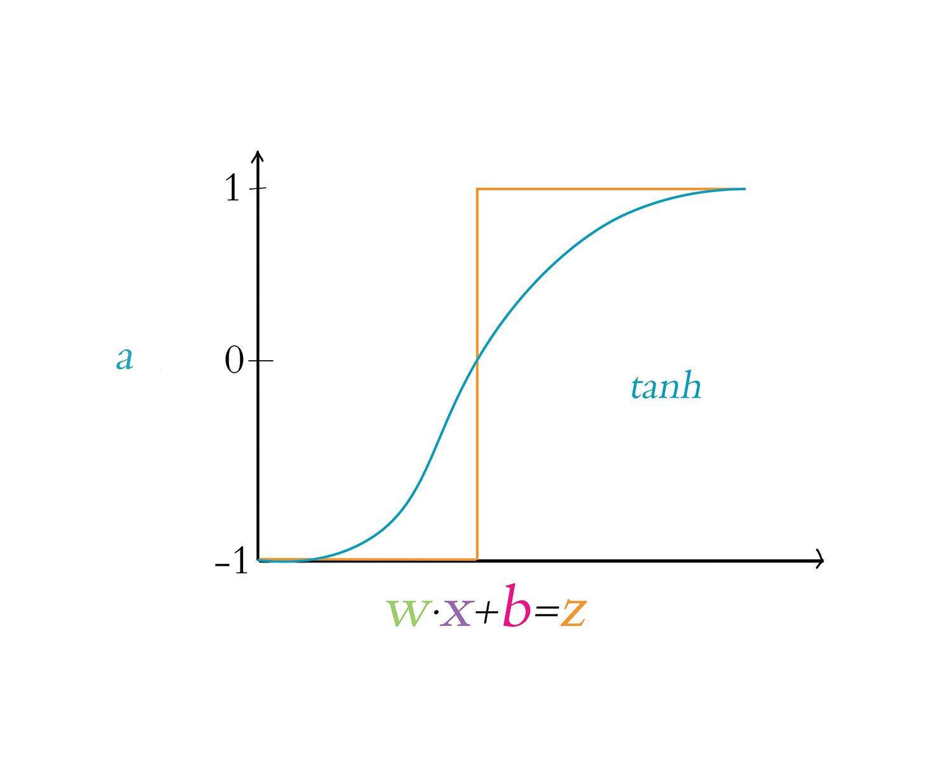

Slide 45
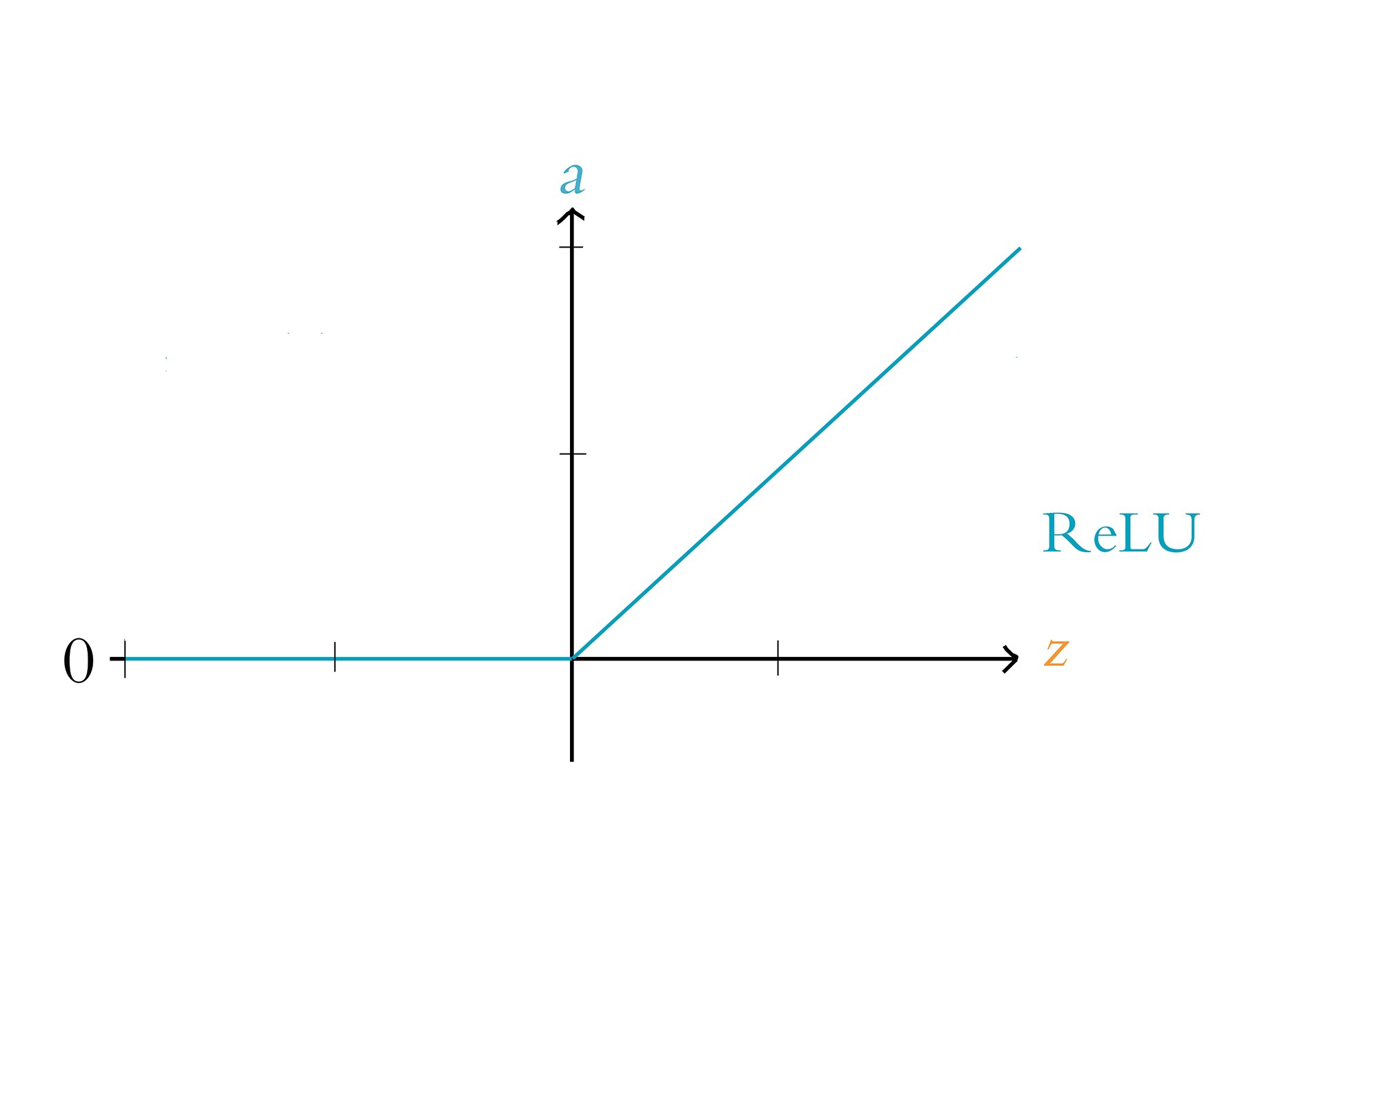

Slide 47
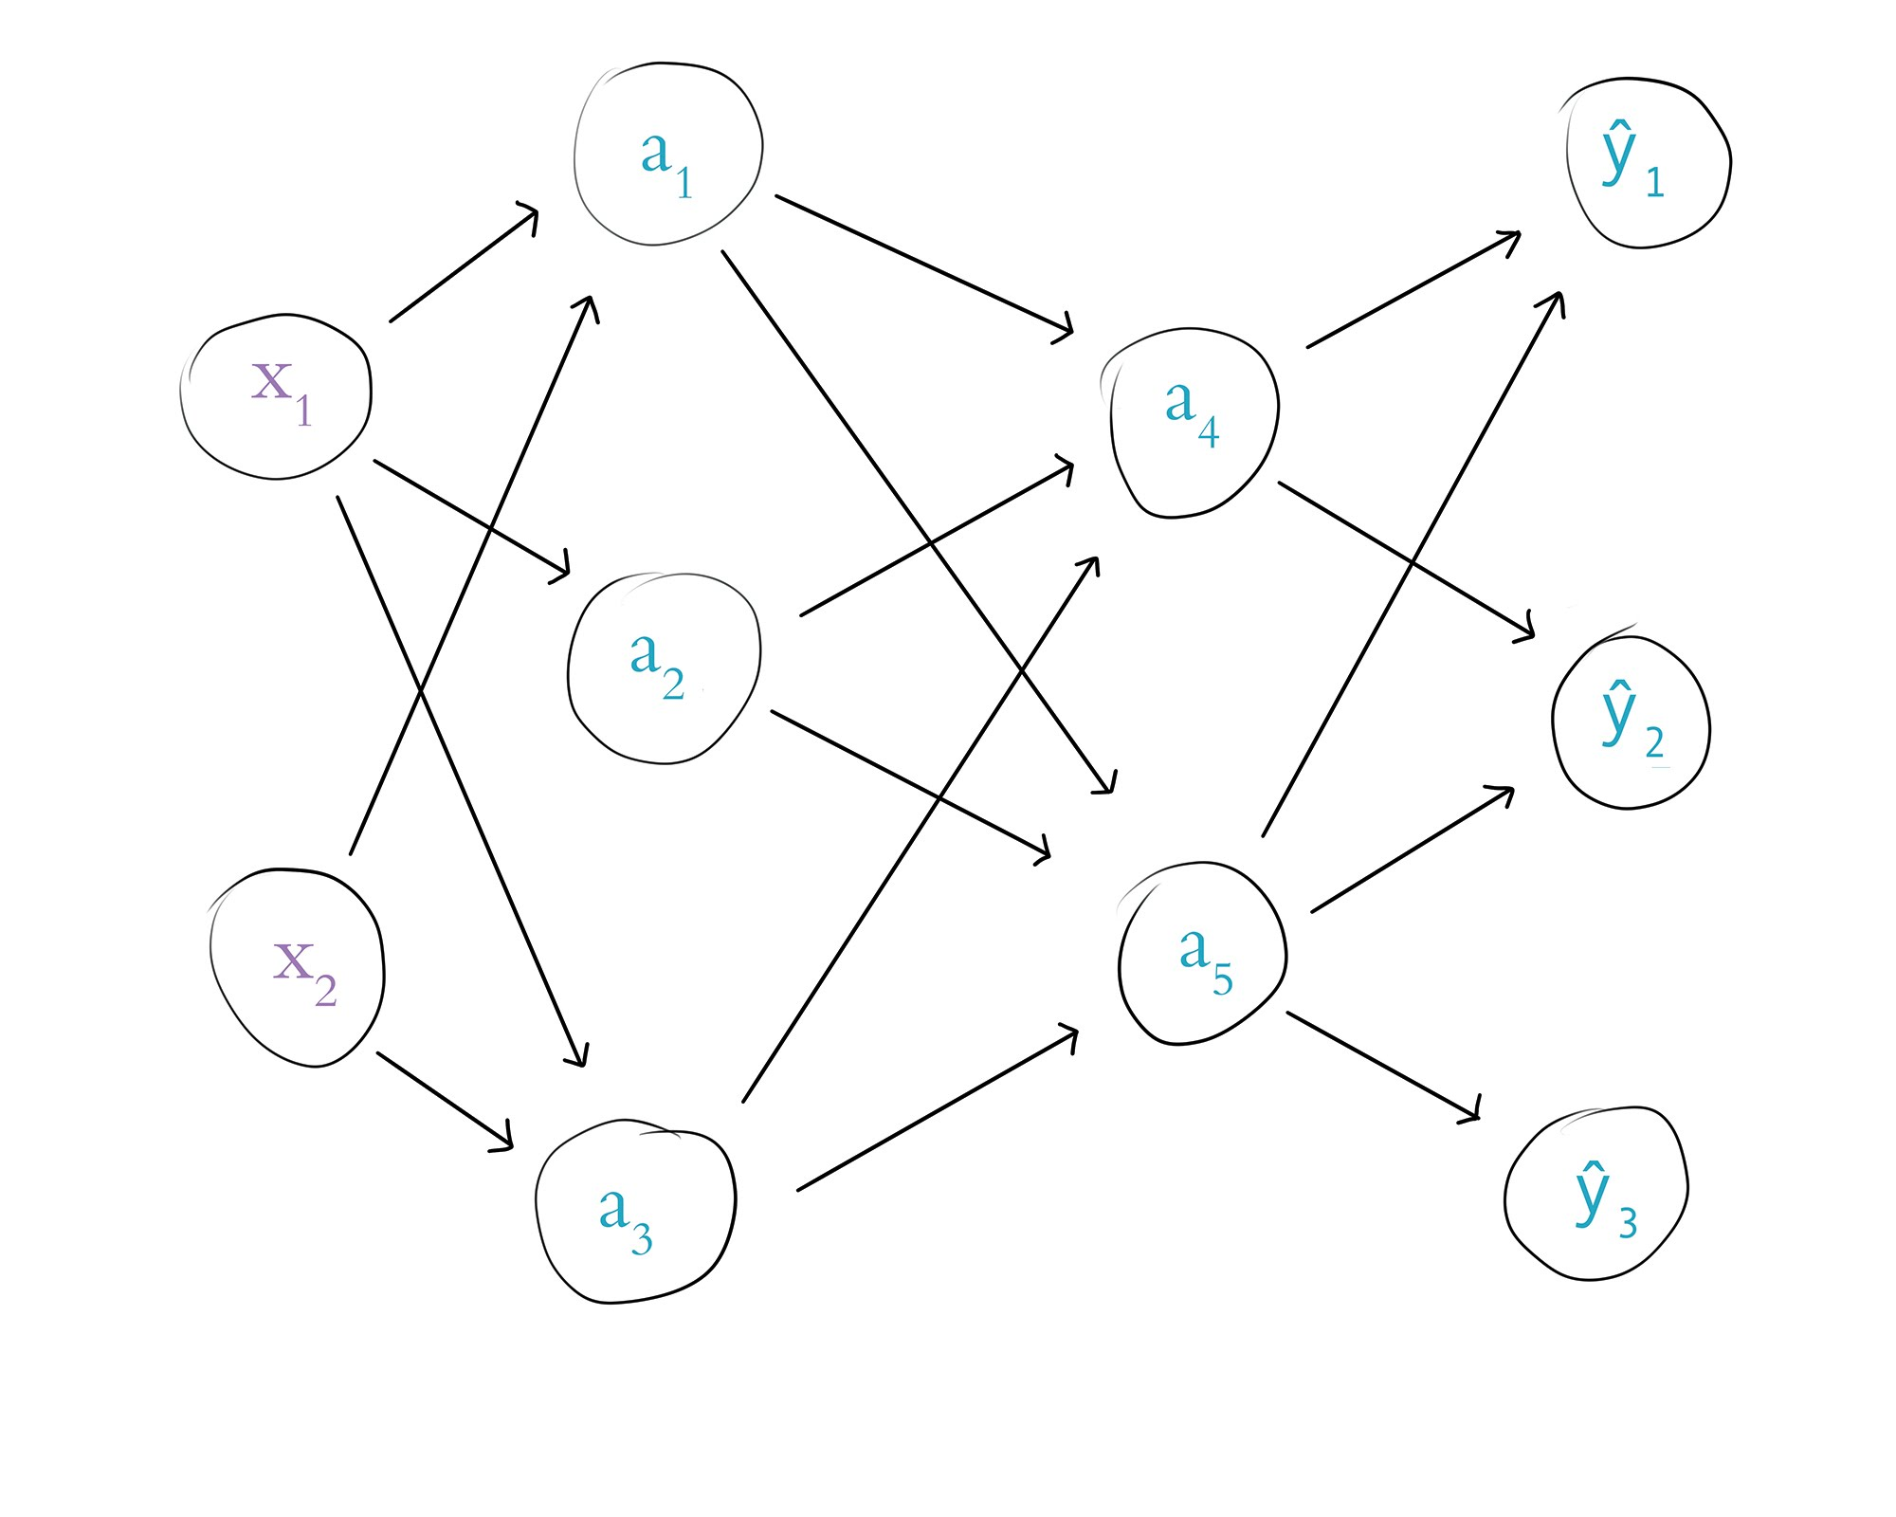
Chapter 7
Define & Build Artificial Neural Networks

Slide 49
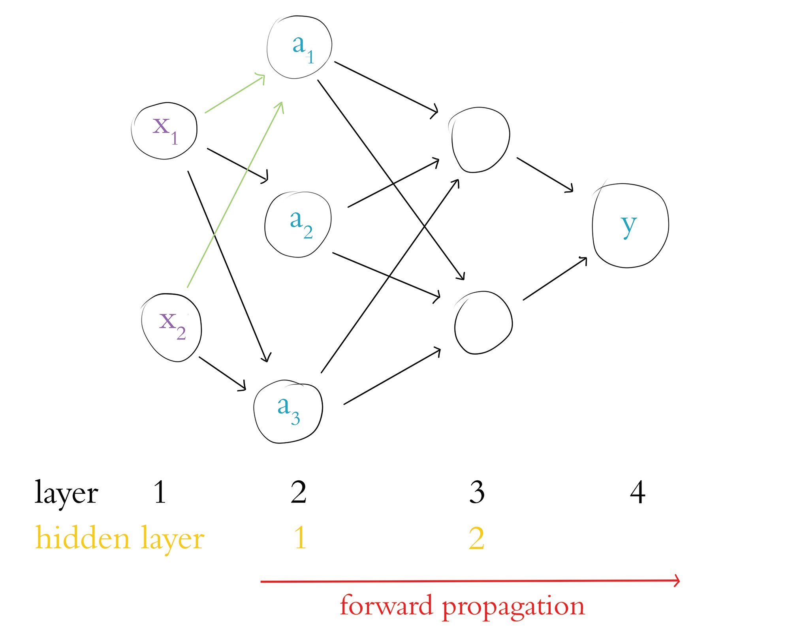

Slide 51
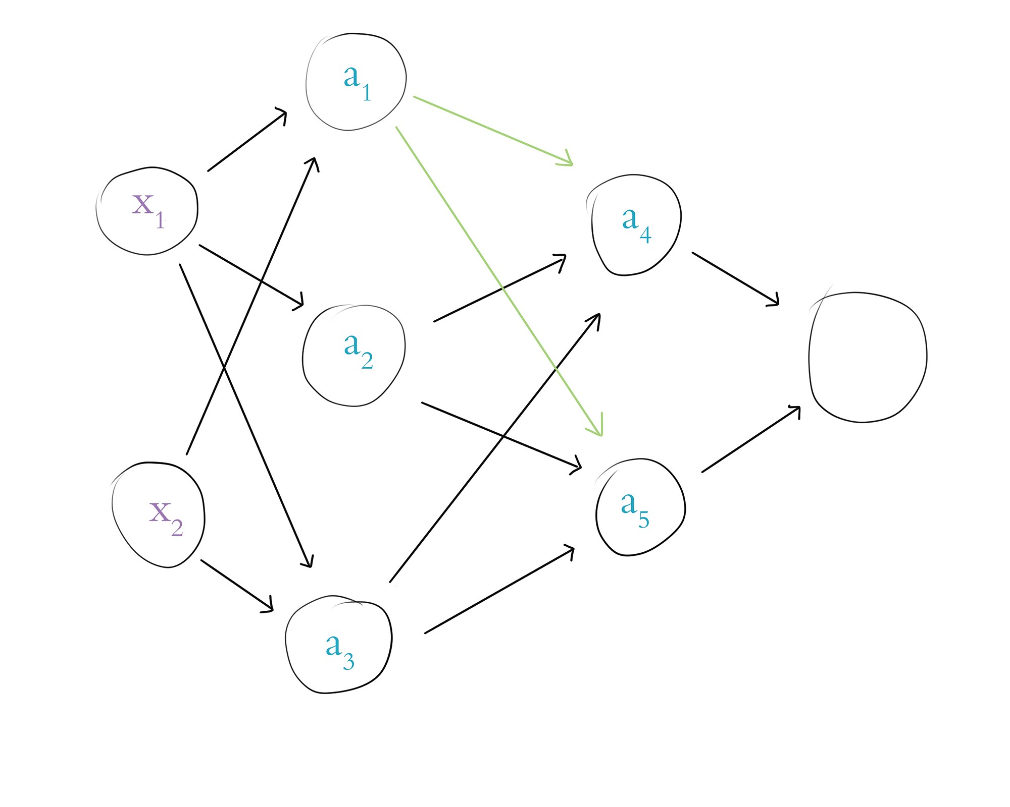

Slide 52
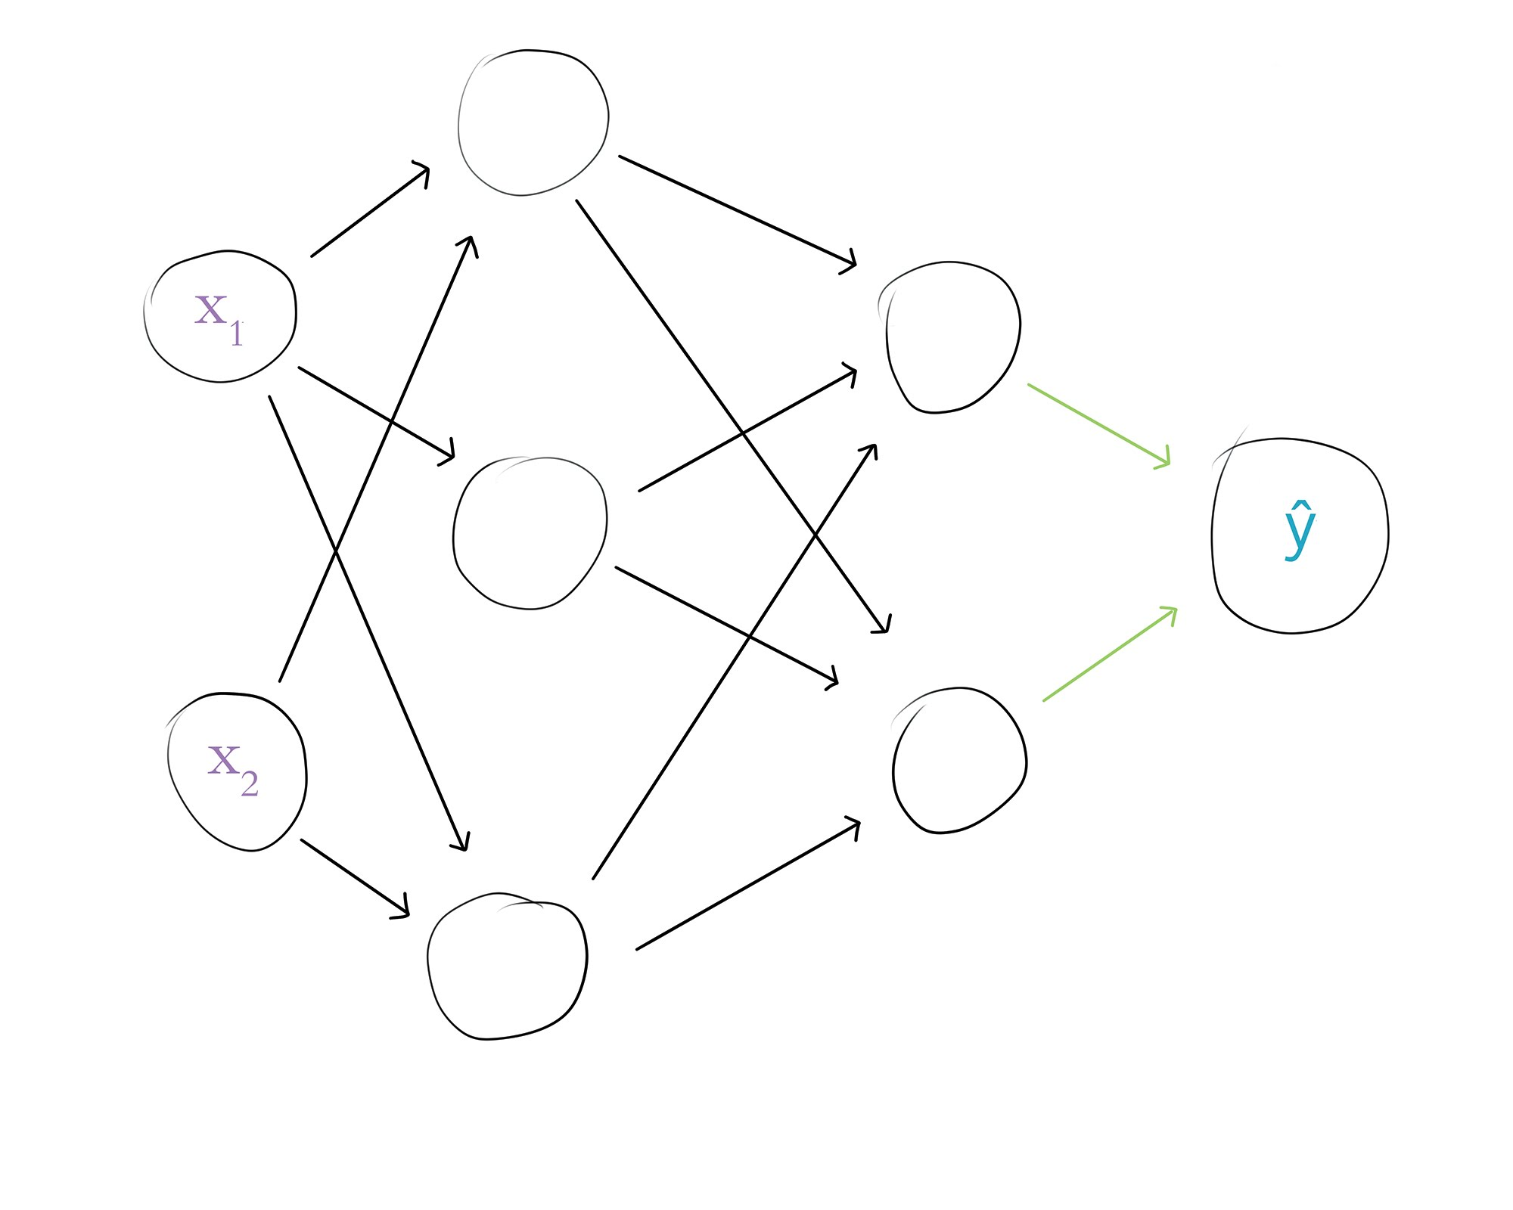

Slide 54
Applied Deep Learning
Module 3:
Chapter 8
Notes:
These are notes for the slide

Slide 55
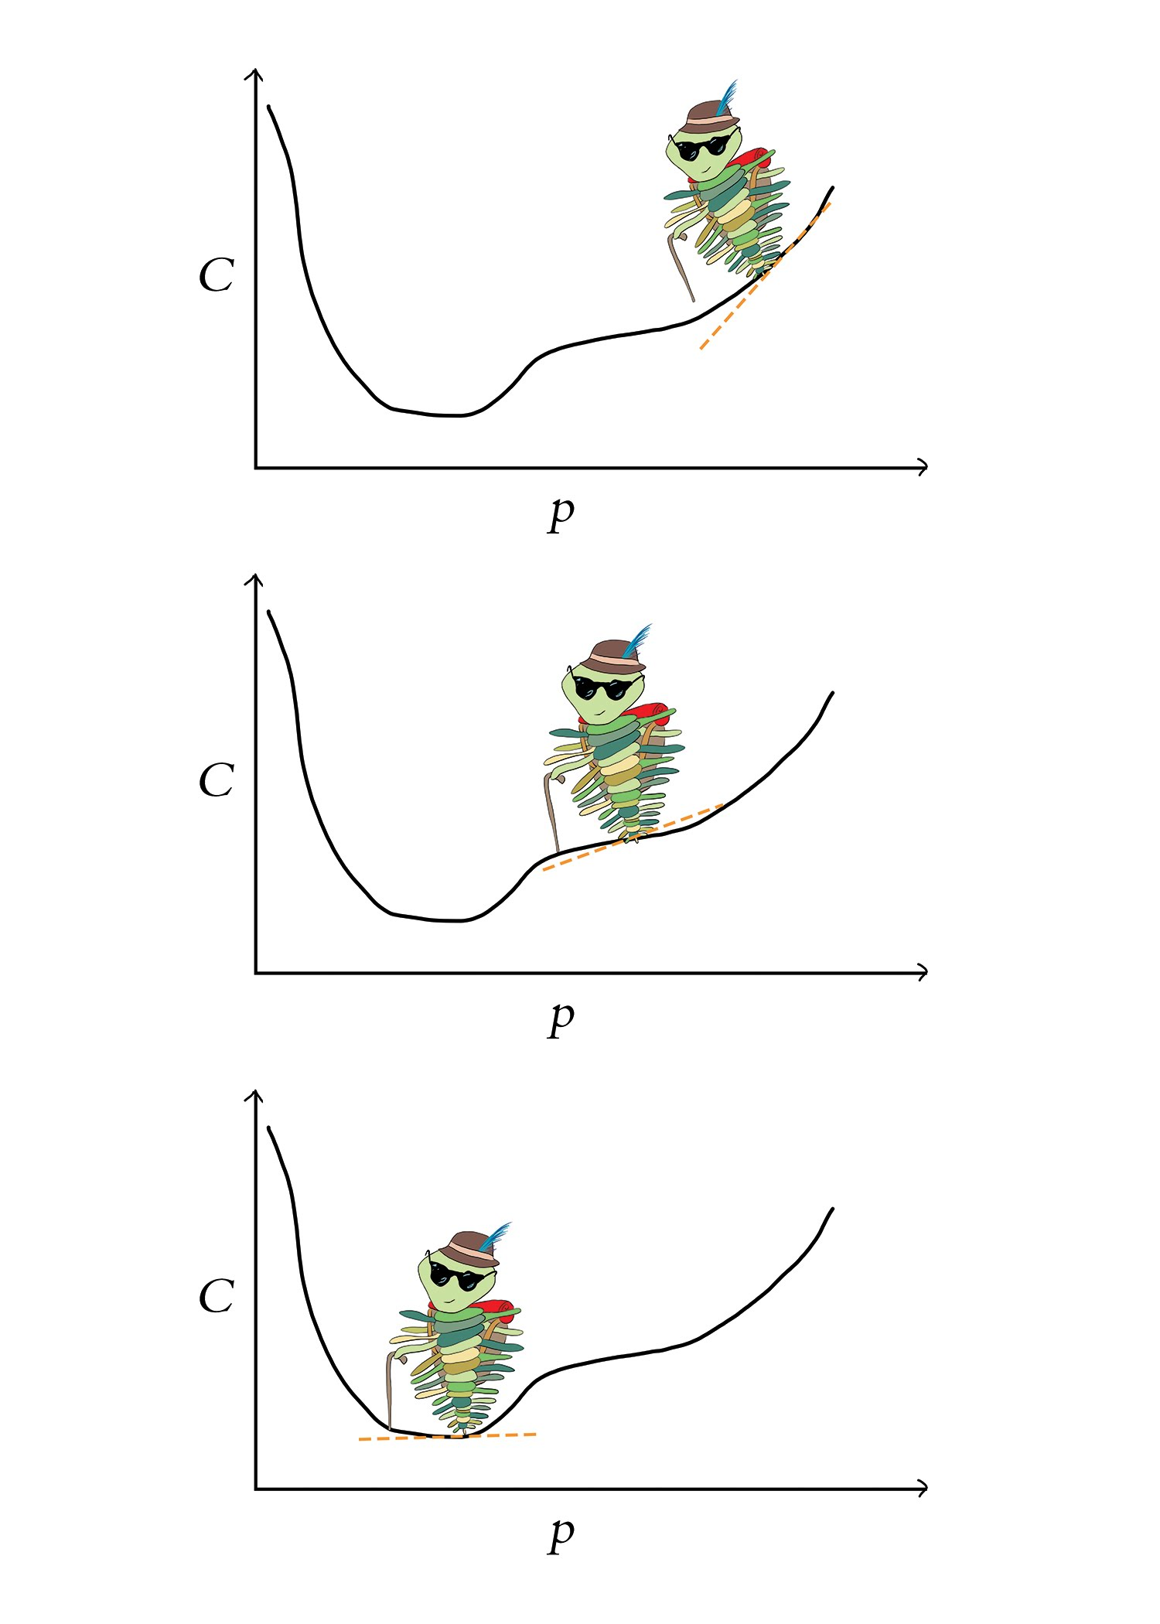
Chapter 8
Training Deep Networks

Slide 56
Cost Functions - Quadratic
Quadratic Cost
AKA: Mean Squared Error
Average of Squared Differences between y and y-hat
Squaring penalizes large differences more severely
Better option than cross-entropy for regression
Can be prone to neuron saturation
Neuron Saturation: changes in z cause very small changes in activation (a).

Slide 57
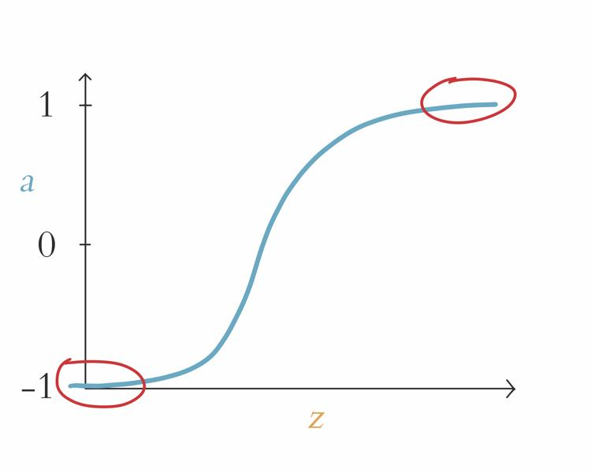
Neuron Saturation

Slide 58
Cost Functions – Cross-Entropy
Cross-Entropy Cost
Configured to allow efficient learning throughout activation curve
Increased cost from differences in y and y-hat
Natural log penalizes large differences more severely using exponentially larger cost
Well suited for classification
Larger the difference between y and y-hat, the faster the neuron learns

Slide 59
Optimization: Learning to Minimize Cost
Cost functions provide a metric for incorrect the estimate is
Two optimizers to minimize cost: gradient descent and back propagation allow network to learn
Model parameters adjusted during learning process, allowing y and y-hat to converge and reducing cost

Slide 60
Gradient Descent

Slide 61
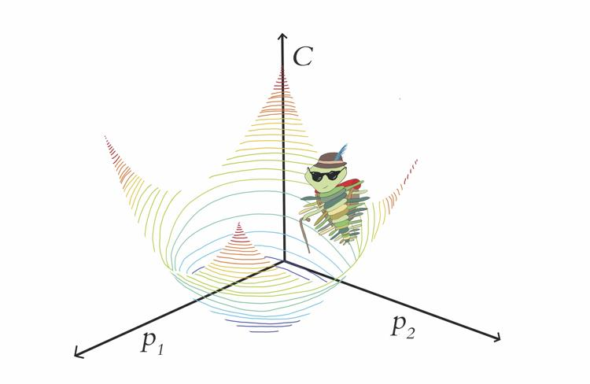

Slide 62
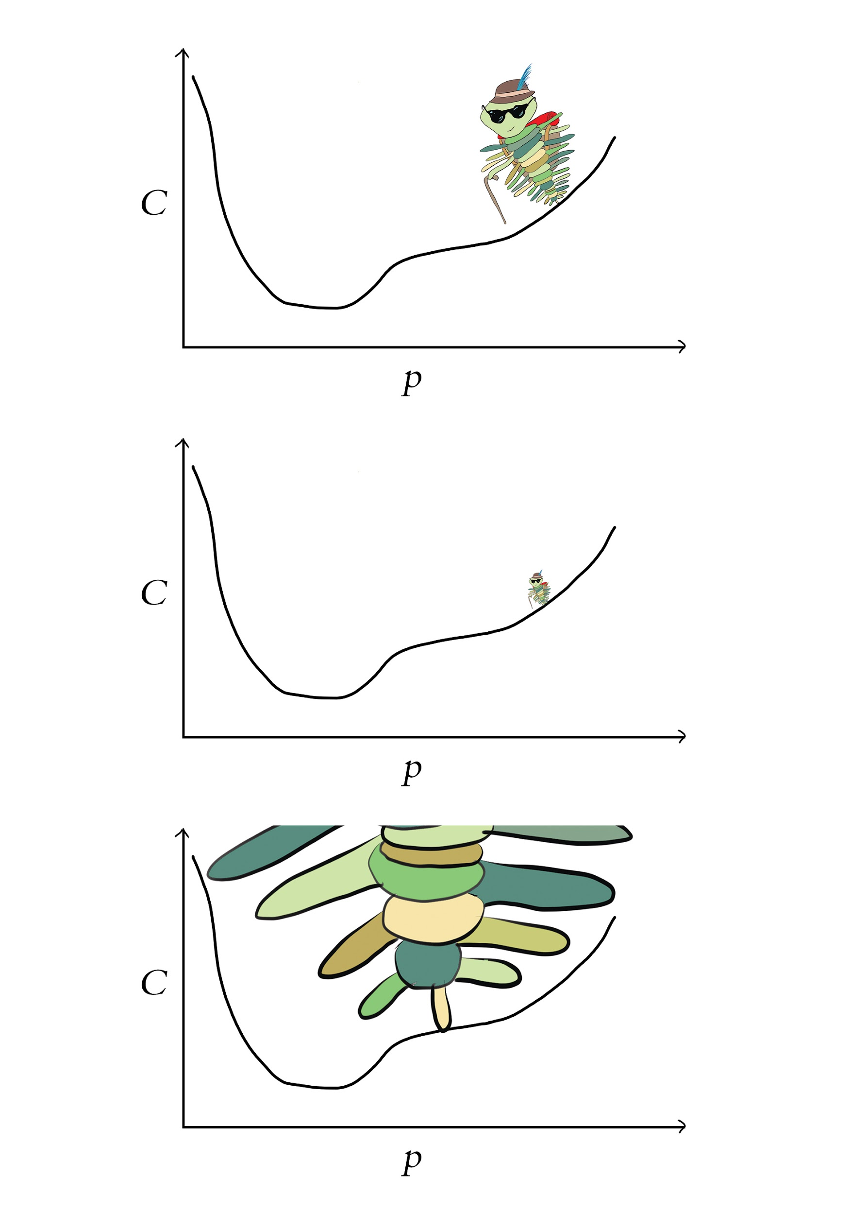
Learning Rate: First Hyperparameter

Slide 63
Learning Rate Tuning
Begin with learning rate of .01 or .001
Adjust the rate by order of magnitude
Book p. 119 for details on manual tuning

Slide 64
Stochastic Gradient Descent
Ordinary gradient descent doesn’t work with large amounts of training data due to memory & compute constraints
Divide data into mini-batches to make gradient descent efficient
Mini-batches randomly selected without replacement in each epoch

Slide 65
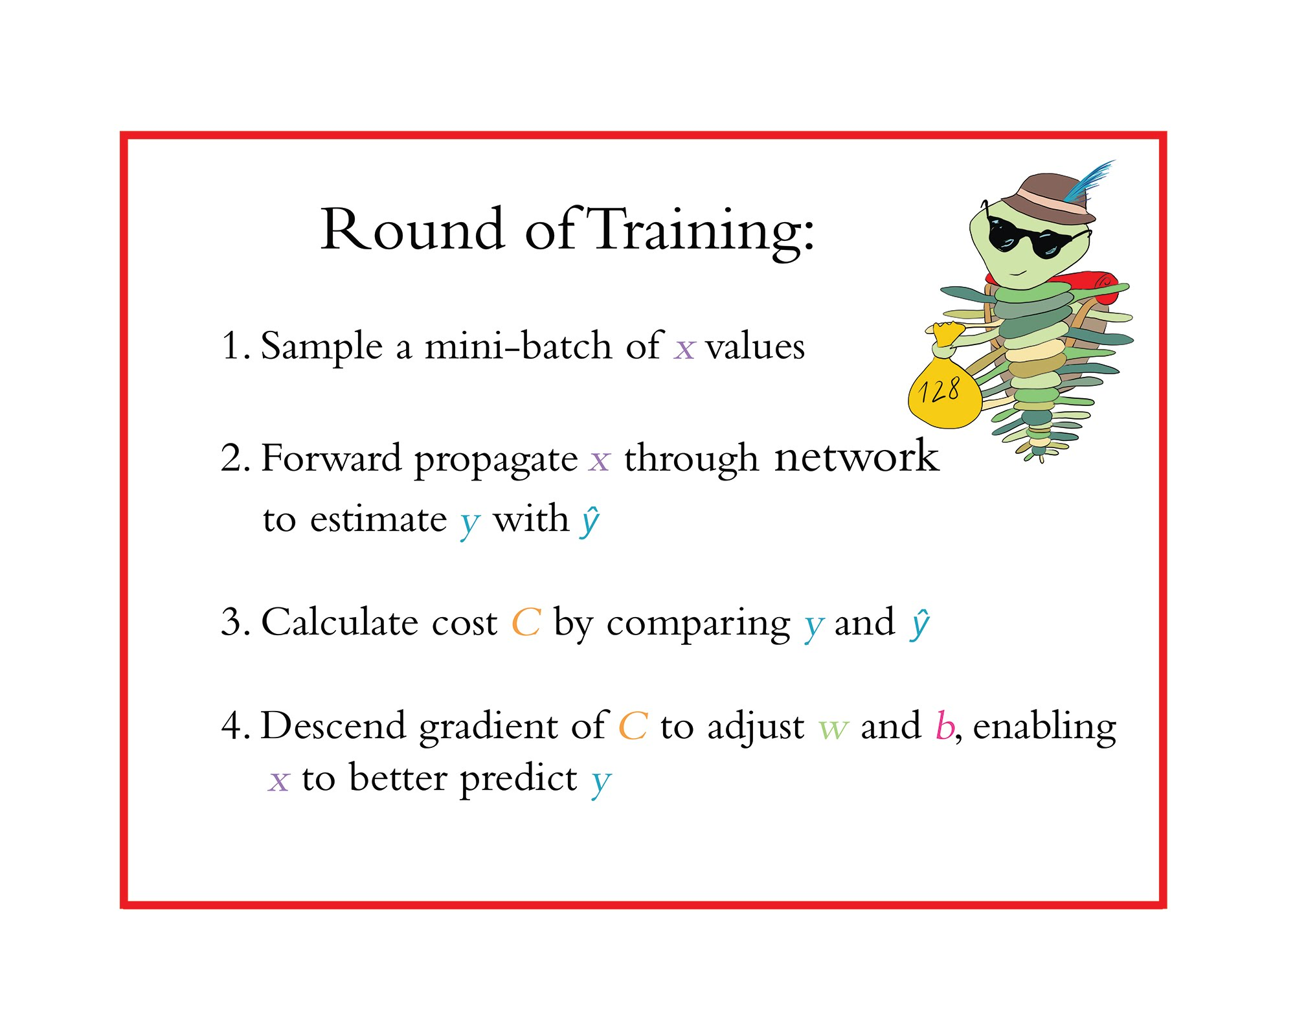

Slide 66
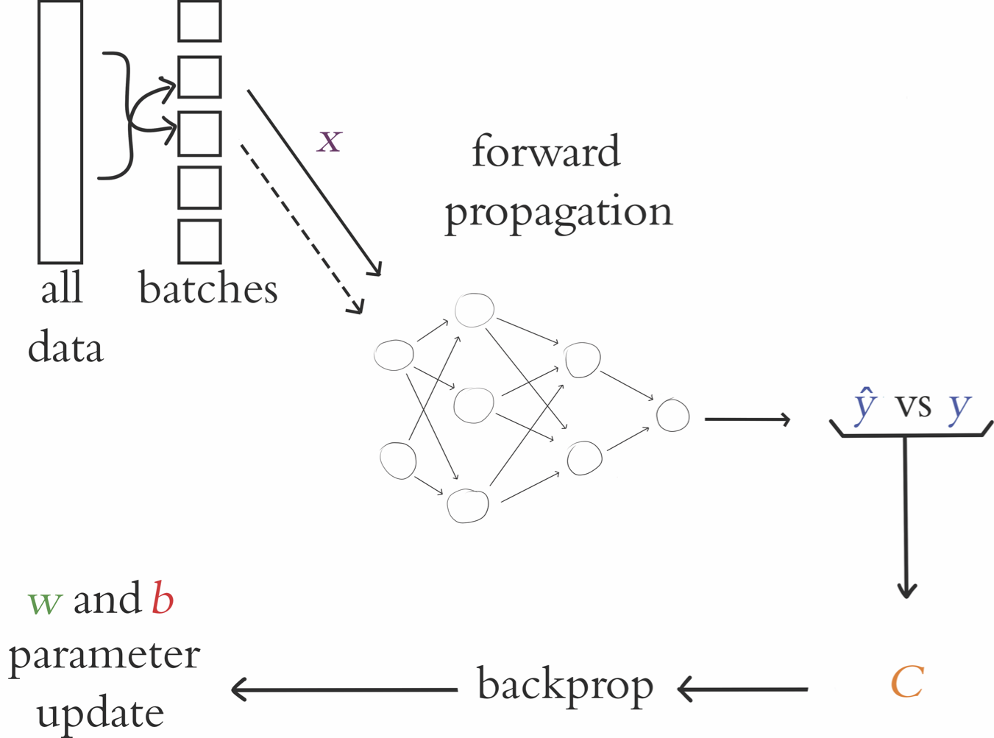
Stochastic Gradient Descent

Slide 67
Epoch Hyperparameter Tuning
If validation cost decreasing, try increasing epochs
If validation cost starts increasing: sign of overfitting
Book p. 122 for details on manual tuning

Slide 68
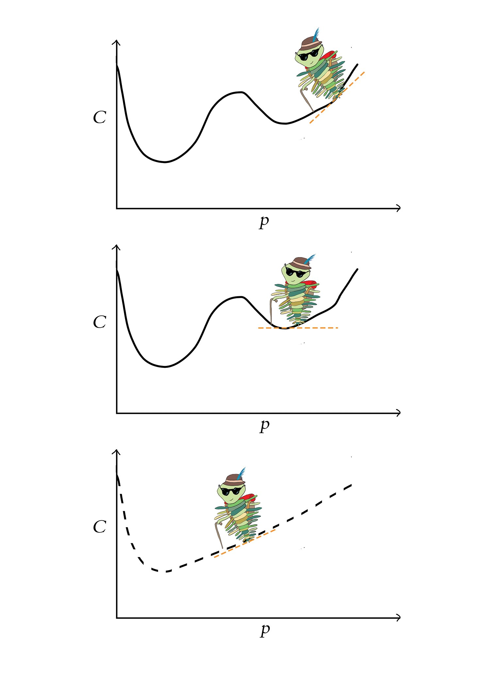
Escaping the Local Minimum of Cost

Slide 69
Batch Size Hyperparameter Tuning
Start with batch size of 32
Increase or decrease by powers of 2 → 32 to 16
Avoid going beyond 128
Book p. 124 for details on manual tuning

Slide 70
Backpropagation
Paired with SGD to efficiently adjust parameters and minimize cost through multiple layers of neurons
Application of “chain rule” in calculus – see appendix B
Carries info about cost backward through network with the goal of reducing cost
Uses cost to calc the relative contribution of every single parameter to the total cost

Slide 71
Hidden Layer & Neuron Count Tuning
Start with 2 to 4 hidden layers
Simplest network to provide desired result is best
Backprop becomes less effective with more hidden layers
Experiment with neuron count in multiples of 2 → 64 to 128
Book p. 126 for details on manual tuning

Slide 72
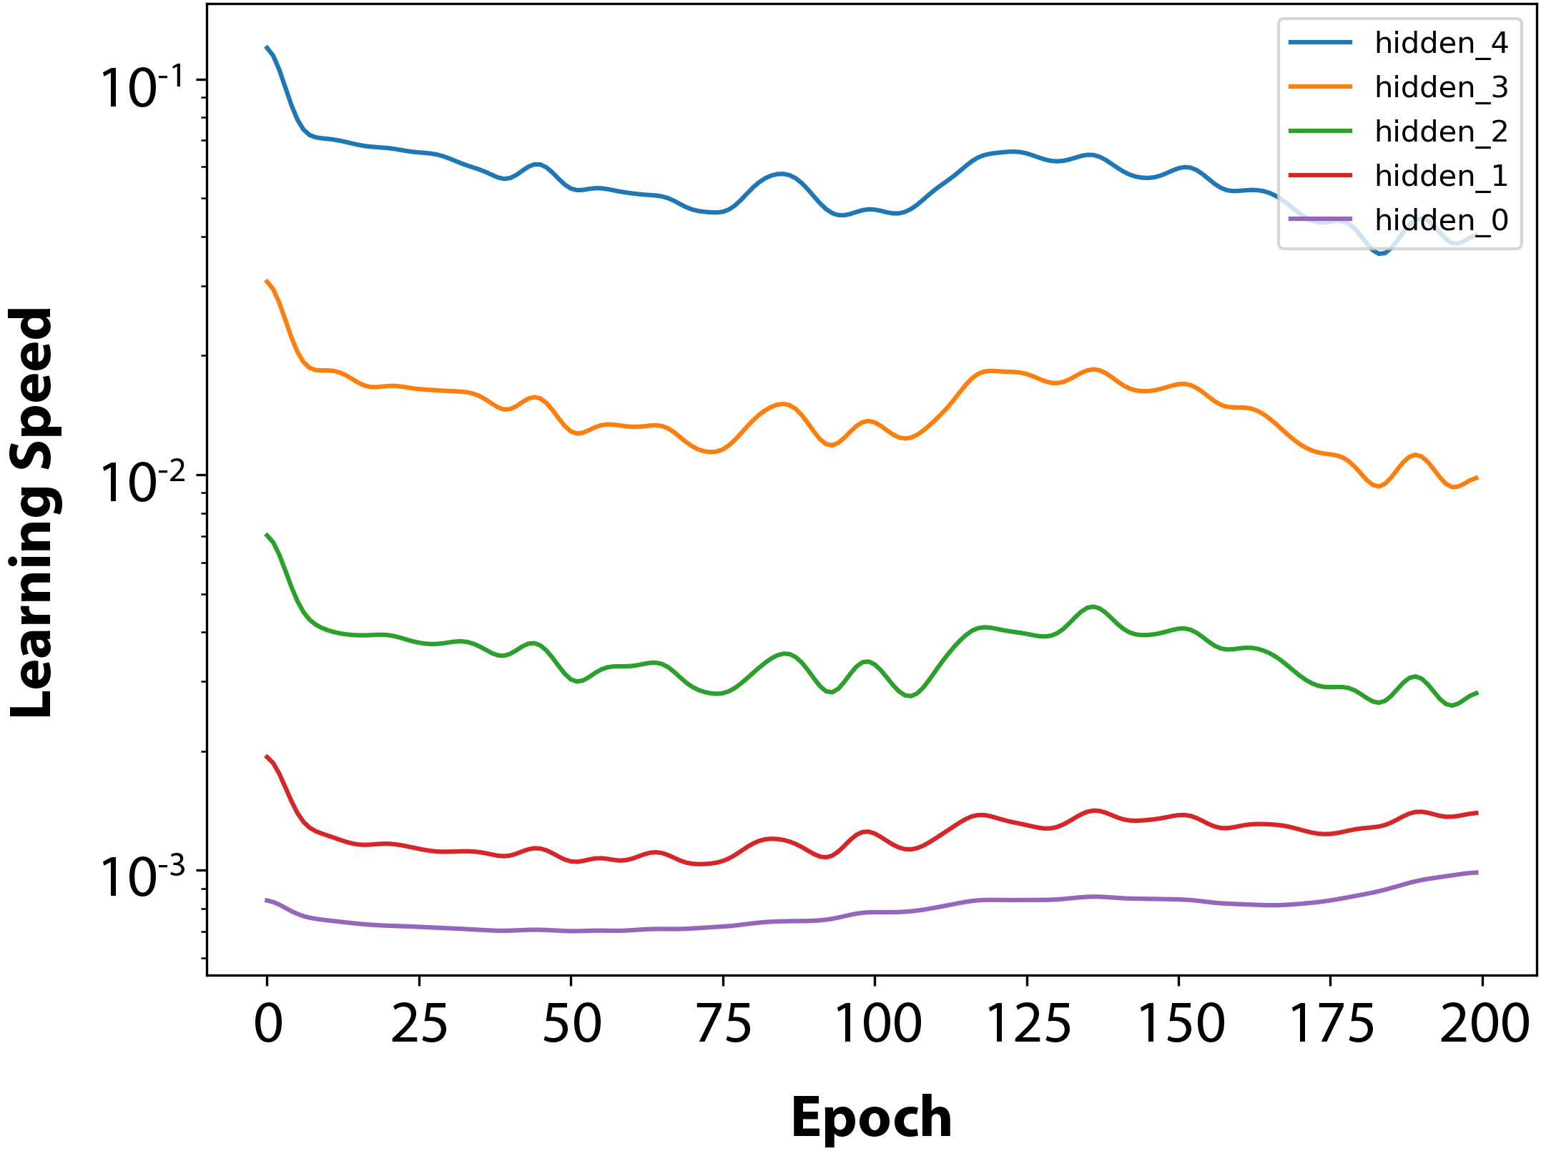
Learning Speed by Layer

Slide 73
Applied Deep Learning
Module 4:
Chapter 9
Notes:
These are notes for the slide

Slide 74
Chapter 9
Improving Deep Networks

Slide 75
Neuron Saturation

Slide 76
Weight Initialization
The goal is to start with reasonably scaled values for w and b.
Large w & b values tend to result in large z values and therefore saturated neurons.
Large parameter values imply strong opinion on how x is related to y → BEFORE any training
Parameter values of zero imply weak relationship
Initialize b parameters with zeros.
Initialize w parameters with values near zero using Glorot distributions.

Slide 77
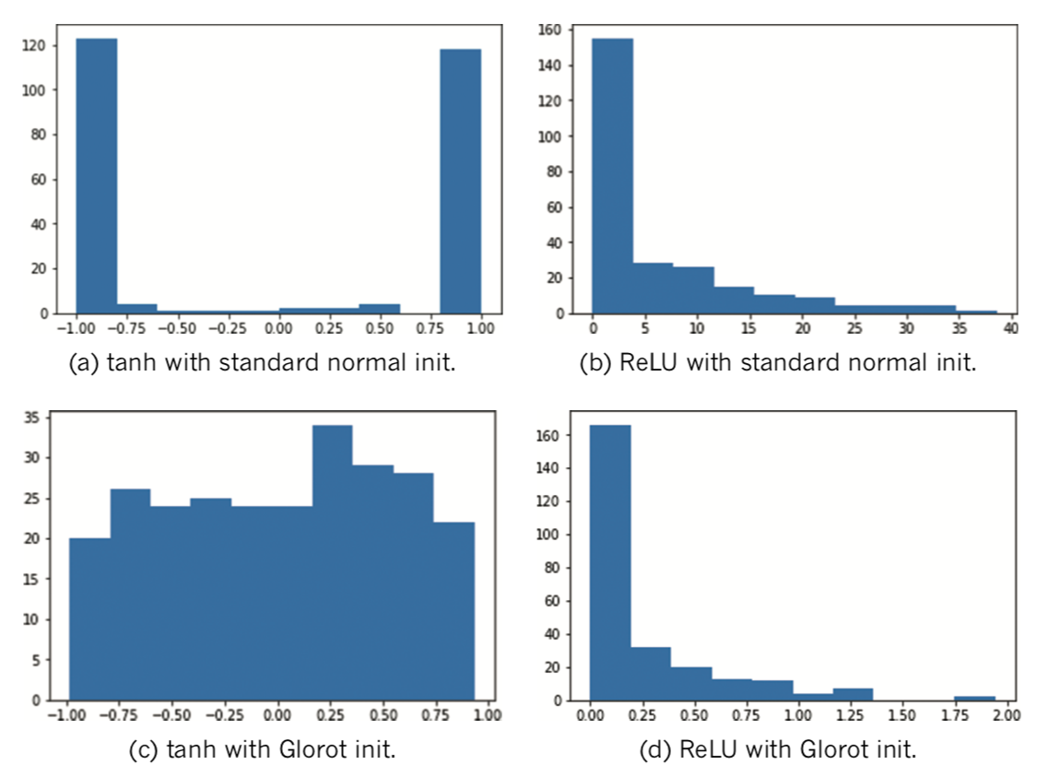
Weight Initializations

Slide 78
Stochastic Gradient Descent

Slide 79
Unstable Gradients
Recall: each parameter adjusted in proportion to its gradient with respect to cost C
Large & positive gradients imply parameter contributes large amount to cost C
Parameter / Cost relationship most direct in hidden layer closest to output
As we move from final hidden layer toward first hidden layer, gradient tends to flatten or vanish
Blindly adding more layers will amplify vanishing gradients
In some architectures, the gradient becomes steep as we move toward the first layer → exploding gradients

Slide 80
Batch Normalization
Recenters the distribution of activations (a) with mean 0 and std deviation of 1
Extreme values in preceding layer won’t cause unstable gradients in next layer
Allows layers to learn independently from each other.
Allows for higher learning rate and thus faster learning.
Improves generalization performance by adding noise element which contributes to regularization.
Adds 2 learnable parameters: gamma and beta
Since they are learnable, the network will adjust them on a layer-by-layer basis depending on what is most helpful.

Slide 81
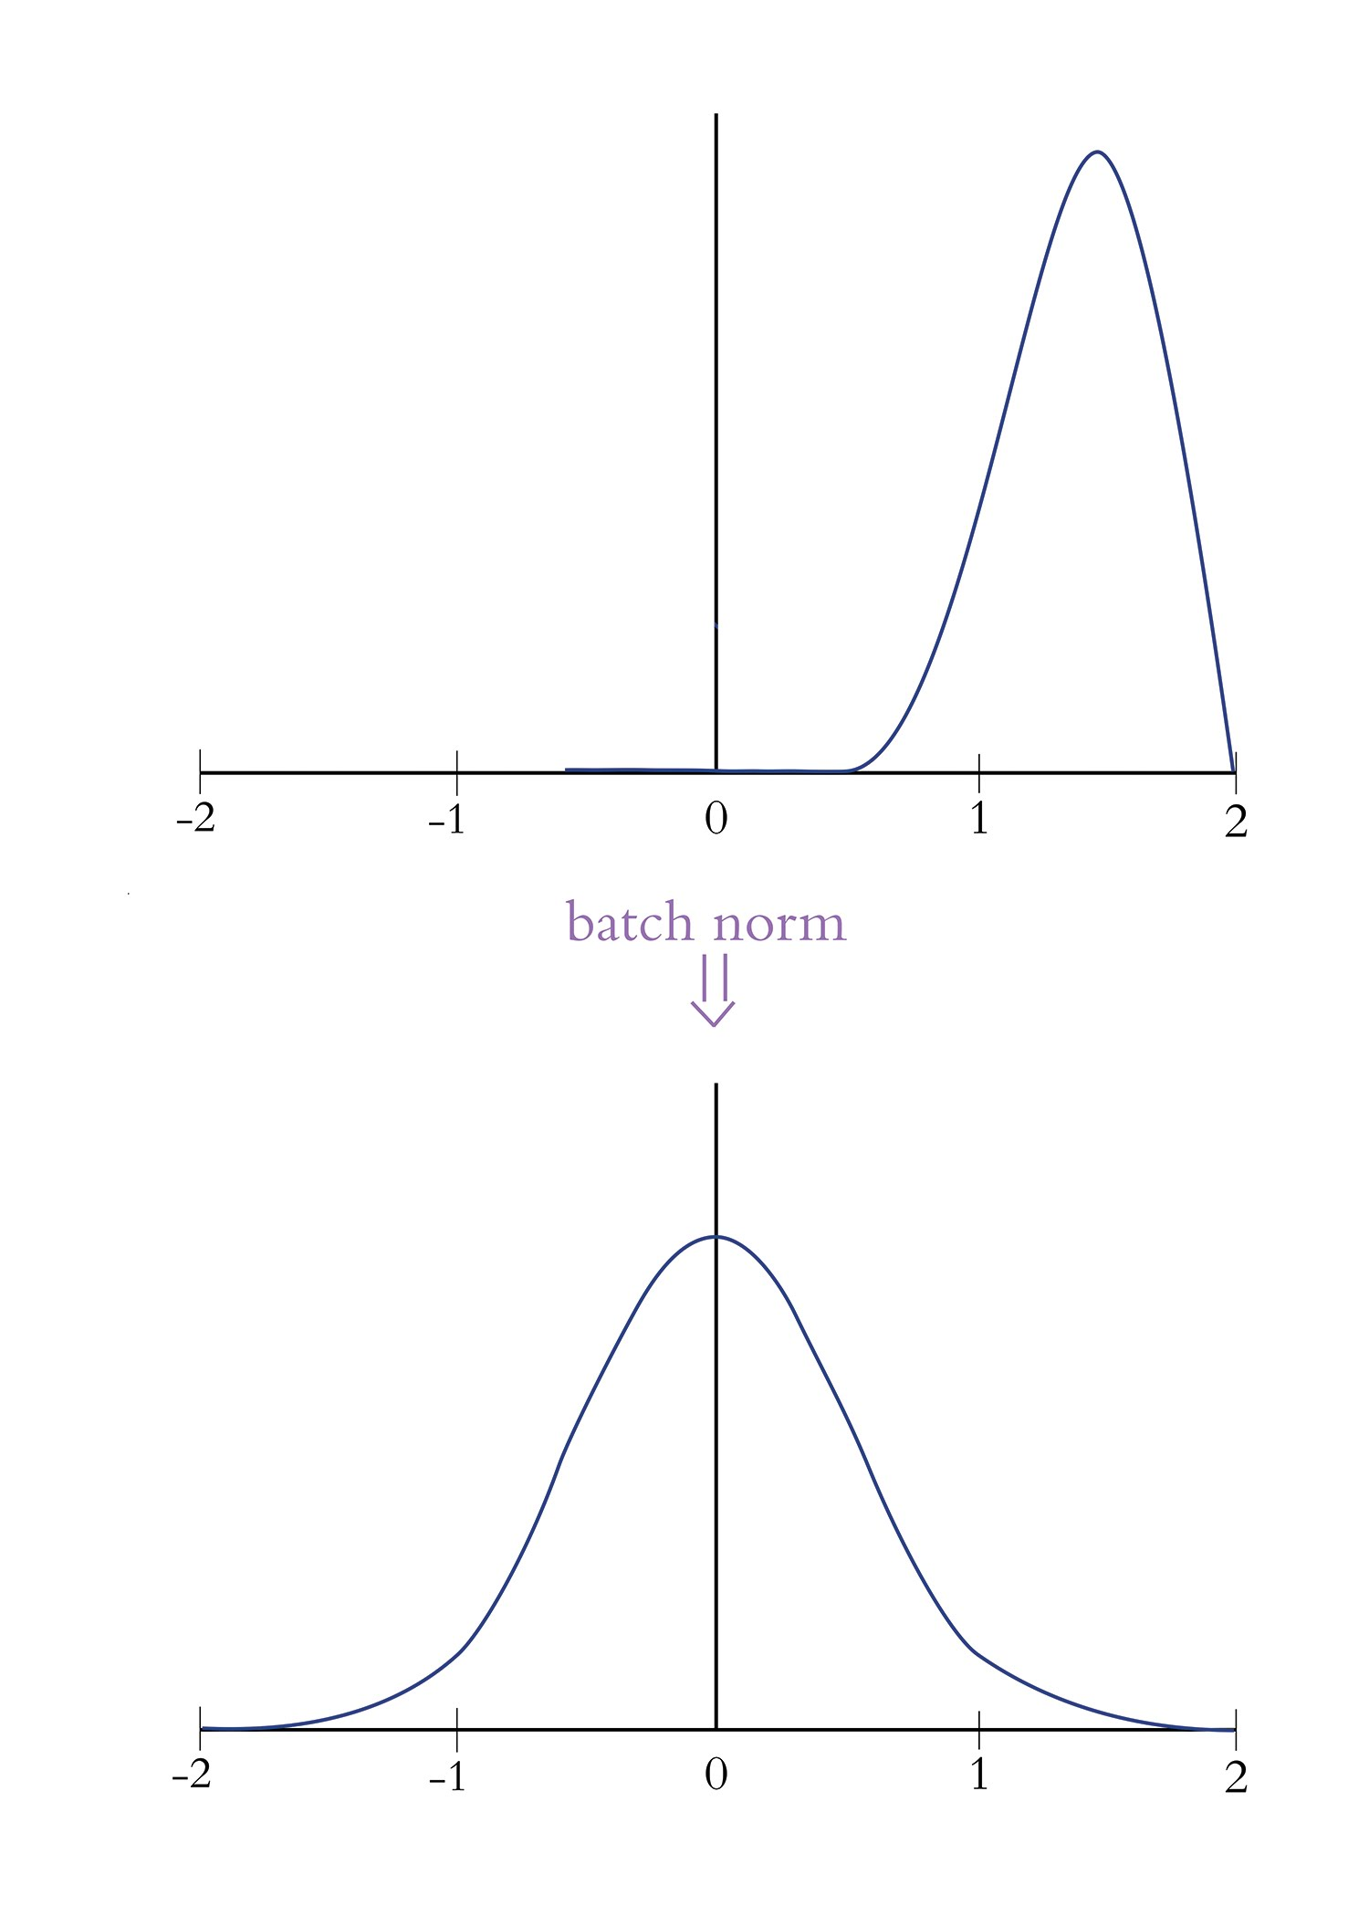
Batch Normalization

Slide 82
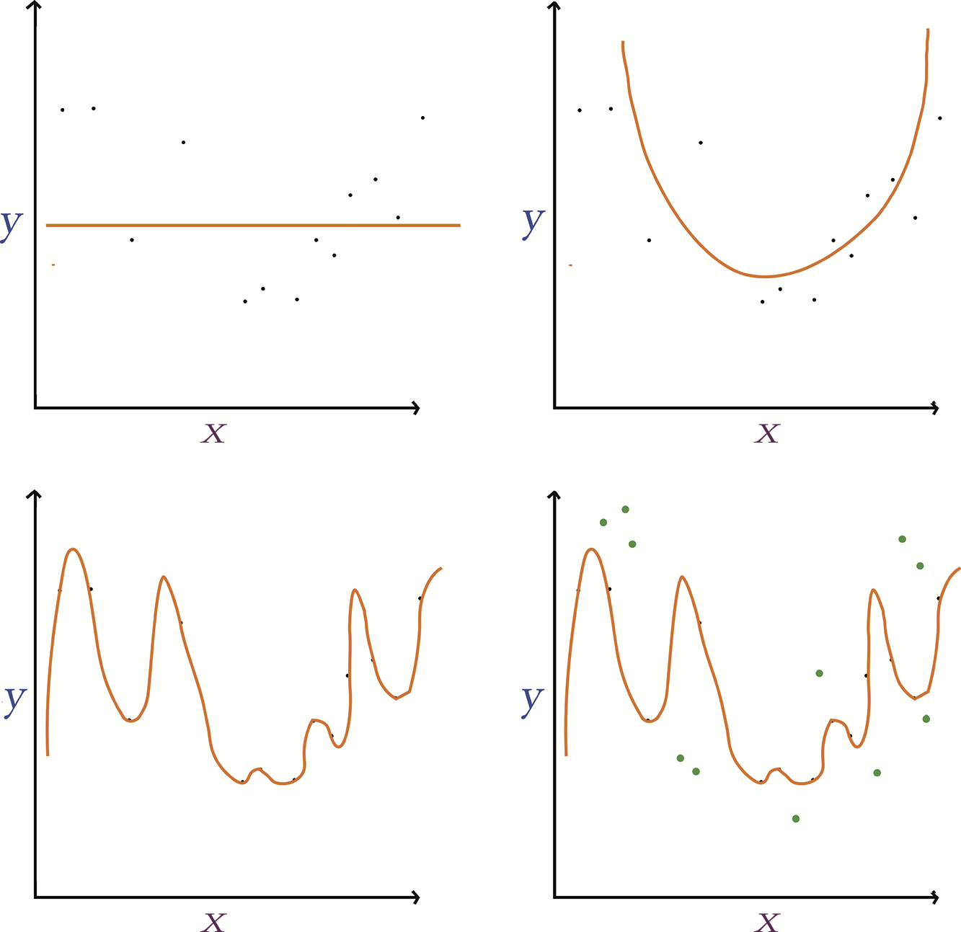
Underfitting and Overfitting

Slide 83
Regularization Techniques
L1/L2 regularization
LASSO and Ridge regression
Dropout
Pretends randomly selected proportion of neurons in each later do not exist during each round of training
Data augmentation
Generate new training data from existing → artificially expanding training data set.

Slide 84
Dropout
Dropout
Pretends randomly selected proportion of neurons in each later do not exist during each round of training.
Prevents single neuron from becoming excessively influential
Parameter-adjustment needed during validation and inference → Keras handles automatically
Dropout rate is hyperparameter: consider adding in later layers of the network.
See page 144 for parameter tuning details

Slide 85
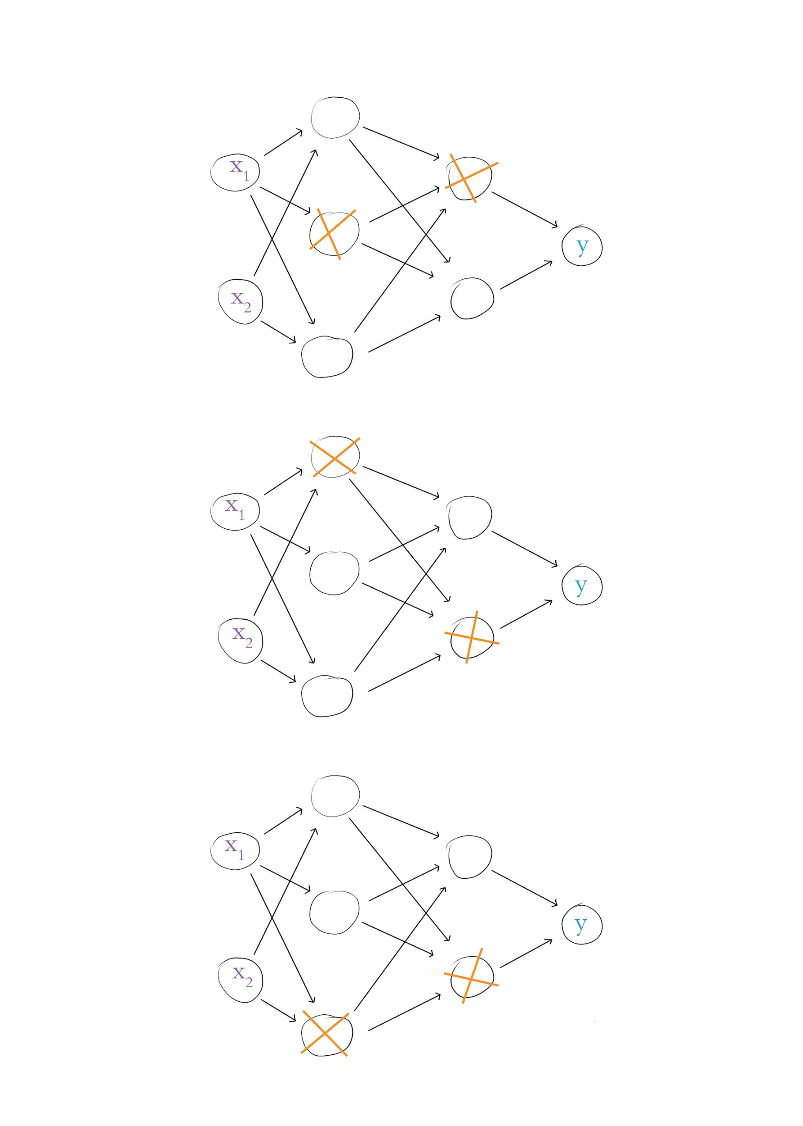
Dropout

Slide 87
Fancy Optimizers
Momentum
Nesterov Momentum
AdaGrad
AdaDelta
RMSProp
Adam
Nadam

Slide 88
Momentum
Moving average of gradients for each parameter used to update weights.
Additional hyperparameter Beta controls how many previous gradients involved in the moving average.
Small Betas allow older gradients to be considered
Larger Betas generally better, with 0.9 as default.

Slide 89
Nesterov Momentum
Takes peek at where momentum may take us.
Uses sneak-peek to execute step from original position.
Trilobite aware of speed, guessing where momentum may take it, and adjusting course accordingly.

Slide 90
AdaGrad
Learning rate for each parameter allows for slowing or halting learning after parameter reaches or nears optimum.
Uses hyperparameter epsilon – safely leave at default.
Allows the learning rate to be set at default and left alone.
One downside is learning rate can shrink significantly with larger past gradient matrices, slowing learning to a halt.

Slide 91
AdaDelta & RMSProp
AdaDelta addresses the gradient matrix size concern of AdaGrad by using MA of previous gradients.
AdaDelta removes the need for learning rate.
RMSProp works similar to AdaDelta but maintains LR.
Both AdaDelta & RMSProp utilize decay rate (rho) hyperparameter which is similar to B in momentum.
Recommended Defaults:
Decay rate (rho) = 0.95
Learning rate = 0.001 for RMSProp

Slide 92
Adaptive Moment Estimation (Adam)
Essentially RMSProp with following exceptions:
Extra MA is used to inform parameter updates as opposed to actual gradients.
Bias trick used to prevent MAs from skewing toward zero.
Hyperparameters
Two B’s: B1=0.9 & B2=0.999.
Learning rate: set at 0.001 and leave it.

Slide 93
Optimizer Wrap-Up
Adam is very popular.
SGD with Momentum is solid and may perform better.
EXPERIMENT to determine what works best for your model architecture and data.

Slide 94
Running TensorBoard
Add to Python code:
from tensorflow.keras.callbacks import TensorBoard
tensorboard = TensorBoard(log_dir=’logs/run-name’)
callbacks = [tensorboard] in model.fit() step
In Terminal, run: tensorboard --logdir='logs/' --port 6006
Visit localhost:6006 in your favorite browser
tensorboard_in_notebooks.ipynb - Colaboratory (google.com)

Slide 95
Applied Deep Learning
Module 5:
Chapter 10
Notes:
These are notes for the slide

Slide 96
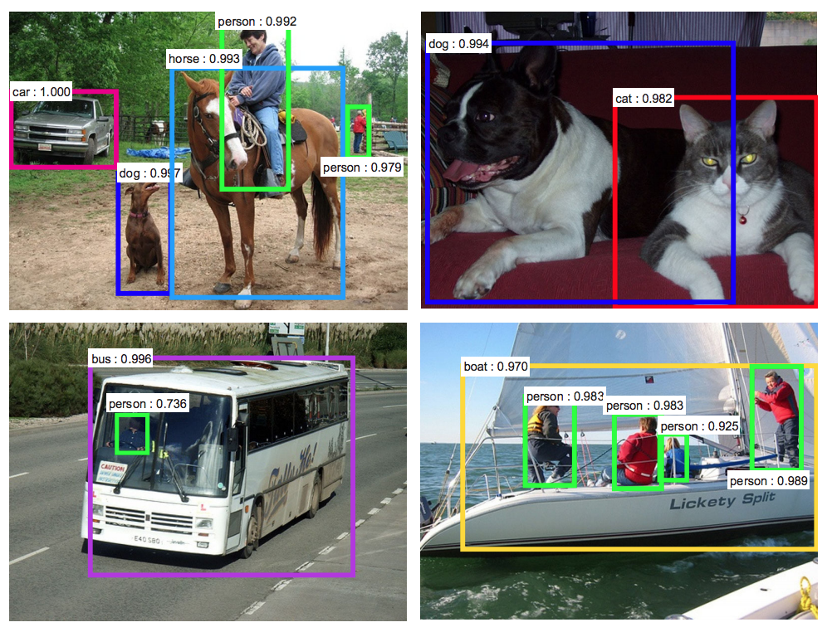
Chapter 10
Machine Vision

Slide 97

The Convolutional Operation
Notes:
- Convolutional layers consist of sets of kernels (filters).

Slide 98

Convolutional Filter Math

Slide 99

Convolutional Example – One Filter
Notes:
Figure 10.3

Slide 100

Convolutional Example – One Filter (2)
Notes:
Figure 10.4

Slide 101

Convolutional Example – One Filter (3)
Notes:
Figure 10.5

Slide 102


Slide 103
Convolutional Filter Hyperparameters
Kernel size
Common to use 3 X 3 or 5 X 5
Too large → too many competing features
Too small → unable to tune to structures
Stride length
Size of step kernel takes moving over the image
Strides of 1 or 2 pixels are common
Padding
Keeps calculations of convolutional layer in order

Slide 104

Activation Map

Slide 105

Max-Pooling

Slide 106

Conv-Pool Blocks for CNNs

Slide 107

A Residual Module

Slide 108


Slide 109

Machine Vision Applications

Slide 110

Image Segmentation
He, K. et al. (2017). arXiv: 1703.06870

Slide 111
Transfer Learning
Takes advantage of library of pre-training model layers
Repurposes them for identifying new classes of objects
VGGNet16 & VGGNet19 are examples

Slide 112
Seminal Image Segmentation Algos
Mask R-CNN
U-Net

Slide 113



VGGNet U-Net Results
1 Epoch
Test Image
9 Epochs

Slide 114

ResNet U-Net Result
VGGNet (9 Epochs)
Test Image
ResNet (4 Epochs)

Slide 115
Object Detection
Ren, S. et al. (2015). arXiv: 1506.01497

Slide 116
Seminal Object Detection Algorithms
R-CNN
Fast R-CNN
Faster R-CNN
YOLO

Slide 117

Capsule Networks

Slide 118
Capsule Networks

